Slide 1
Preference Elicitation Part 1/3
COMP6203 Intelligent Agents
November 2020
Dr Baharak Rastegari
b.rastegari@soton.ac.uk
Electronics and Computer Science
University of Southampton

Slide 2
Part 1

Slide 3
Learning Outcomes
By the end of this lecture (part 1), you should be able to
Define a preference ordering and the conditions usually assumed.
Describe reasons for preference uncertainty and the two preference elicitation methods explained (pairwise comparisons and interviews).
Describe the differences between pairwise comparisons and interviews.
Define an elicitation plan.

Slide 4
Recap on Preferences

Slide 5
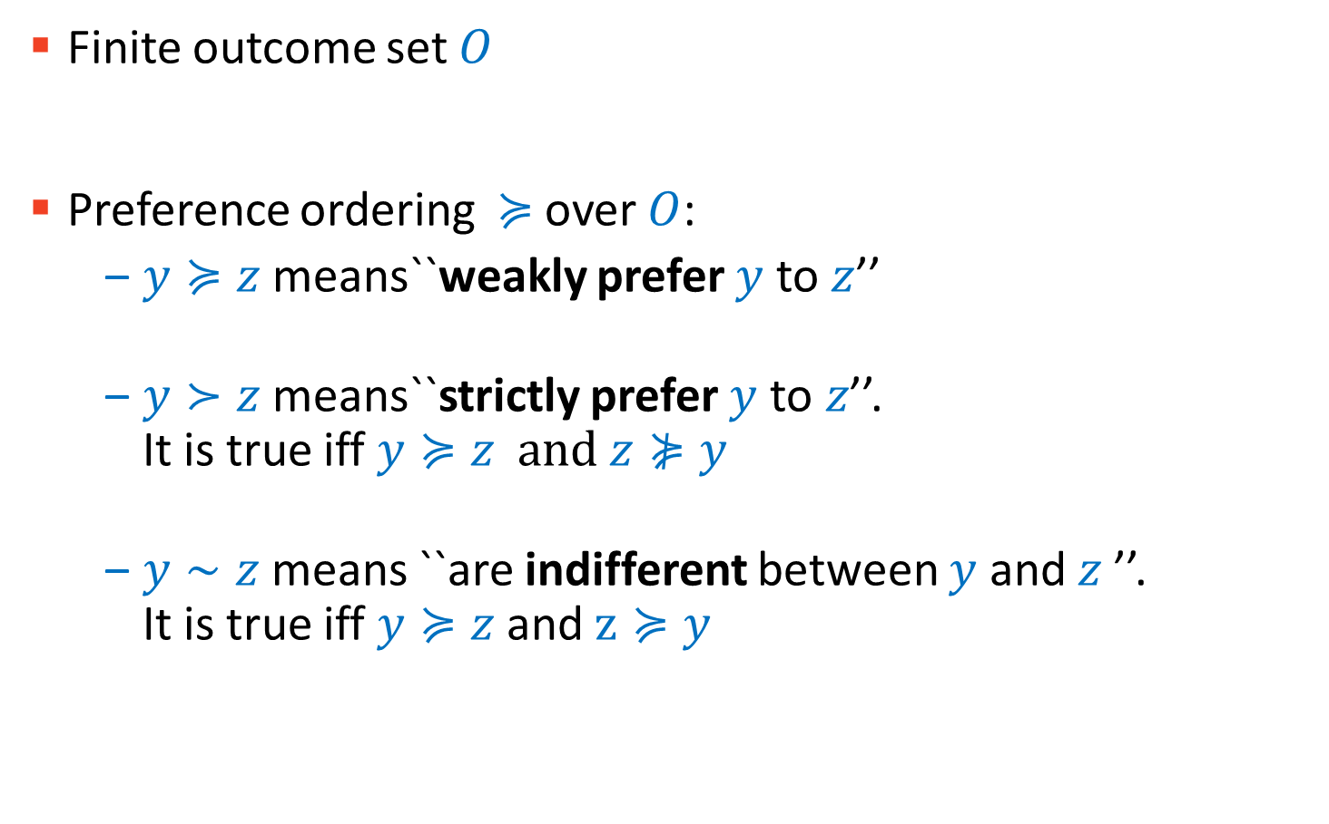
Preference Orderings
Finite outcome set $O$
Preference ordering $≽$over $O$:
$y≽z$means``weakly prefer $y$ to$z$’’
$y≻z$means``strictly prefer $y$ to$z$’’. It is true iff $y≽z and z⋡y$
$y∼z$means ``are indifferent between $y$ and$z$’’. It is true iff $y≽z$and $z≽y$

Slide 6
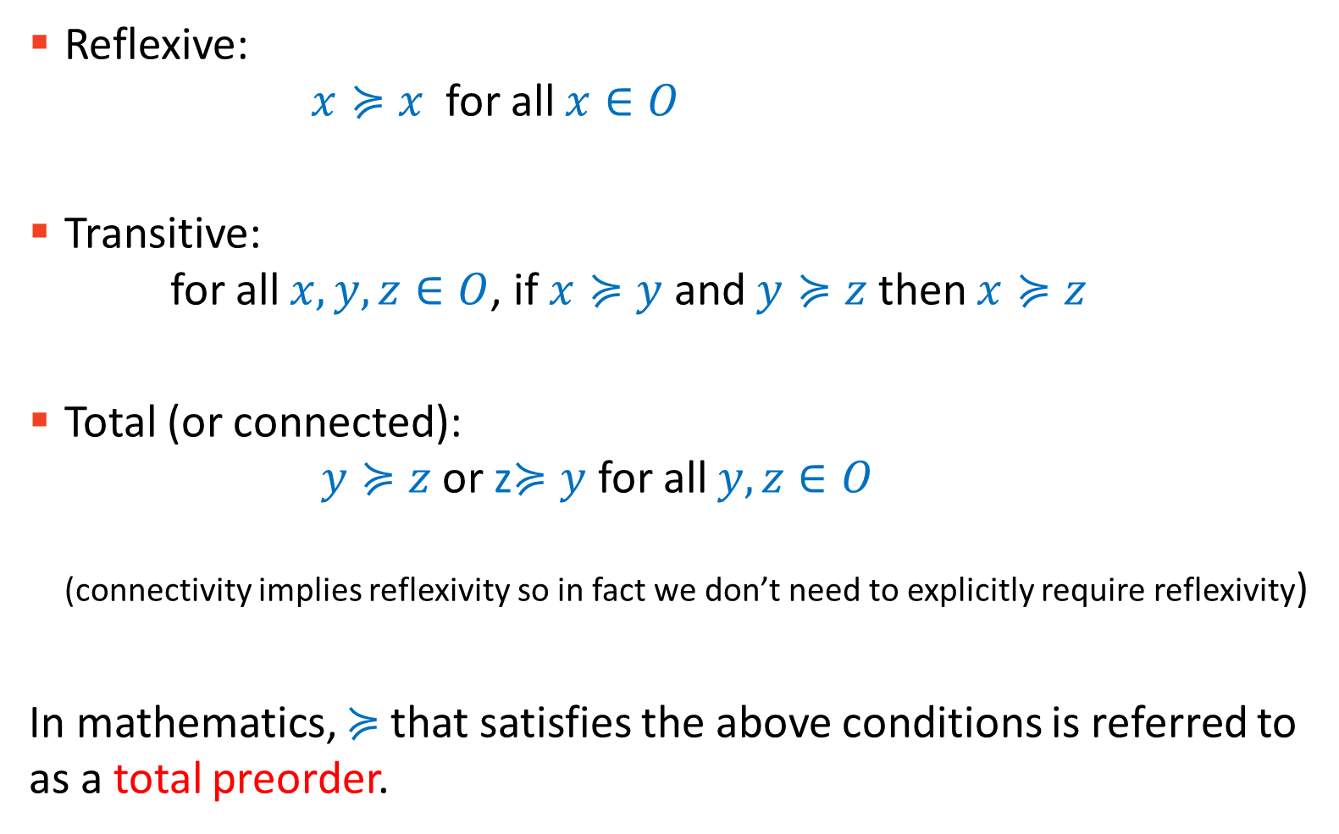
Conditions
Reflexive: $x≽x$ for all $x∈O$
Transitive: for all $x, y, z∈O$, if $x≽y$ and $y≽z$ then $x≽z$
Total (or connected): $y≽z$or z$≽y$ for all $y,z∈O$ (connectivity implies reflexivity so in fact we don’t need to explicitly require reflexivity)
In mathematics, $≽$that satisfies the above conditions is referred to as a total preorder.

Slide 7

Transitivity
If $x≽y$ and $y≽z$ then $x≽z$
If $x∼y$ and $y∼z$ then?
If $x≻y$ and $y≻z$ then ?
If $x≽y$ and $y≻z$ then ?
If $x≻y$ and $y≽z$ then ?

Slide 8
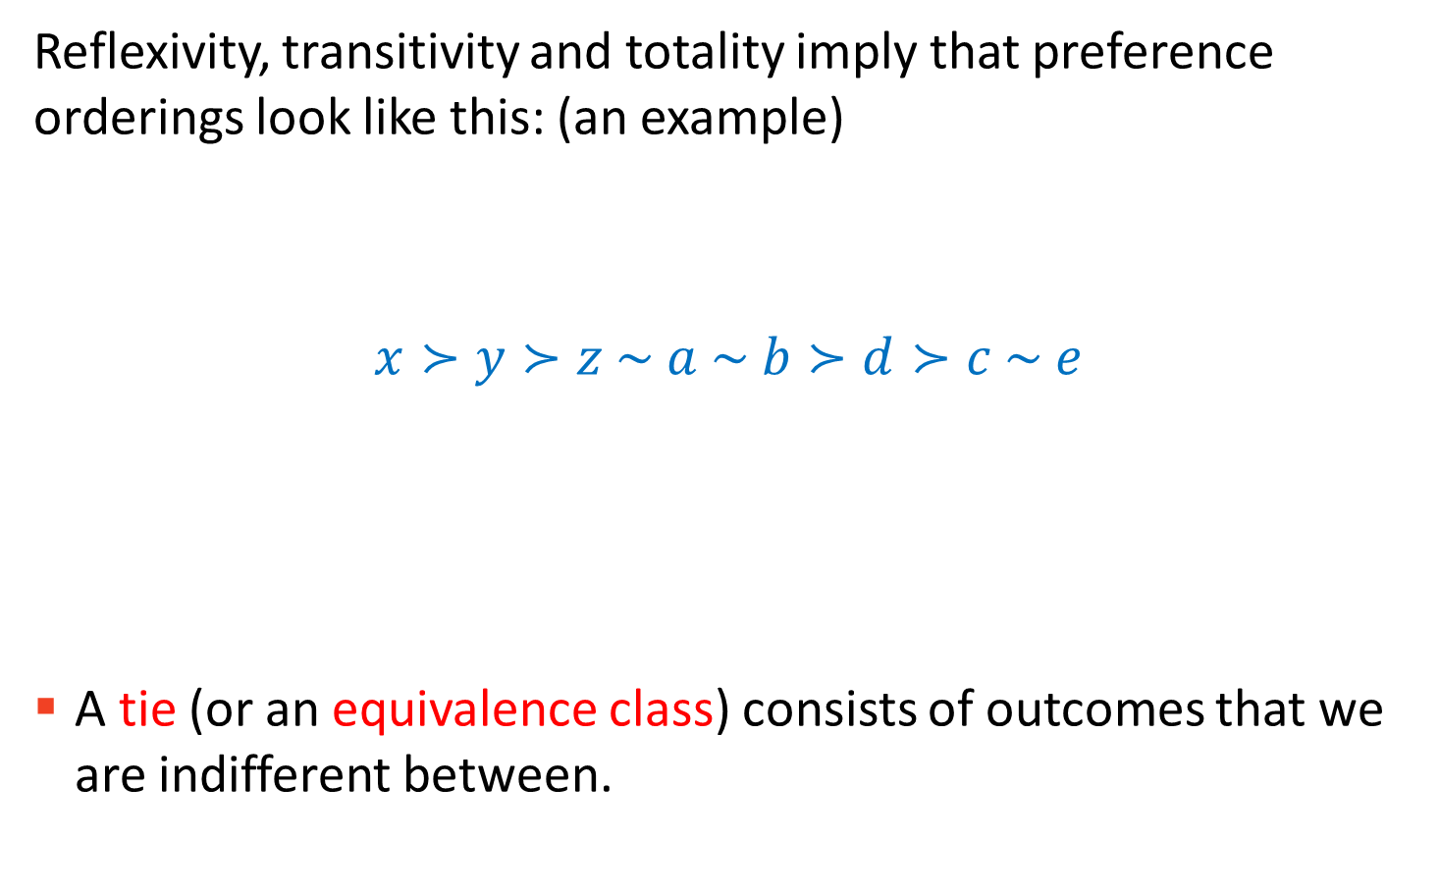
How do Preference Orderings look like?
Reflexivity, transitivity and totality imply that preference orderings look like this: (an example)
$$x≻y≻z \sim a \sim b≻d≻c \sim e$$
A tie (or an equivalence class) consists of outcomes that we are indifferent between.
Tie
Tie

Slide 9
Revisiting Transitivity
Transitivity implies that I cannot prefer apple to orange, orange to pineapple and then pineapple to apple!
Sometimes we have several preferences that need to be aggregated. E.g.
a hiring committee is ranking applicants who have been shortlisted for a job;
each member of the committee independently provides a ranking over the candidates; then these individual preferences need to be aggregated.
(We will discuss the aggregation of preferences in 2 weeks in the voting lecture.)

Slide 10
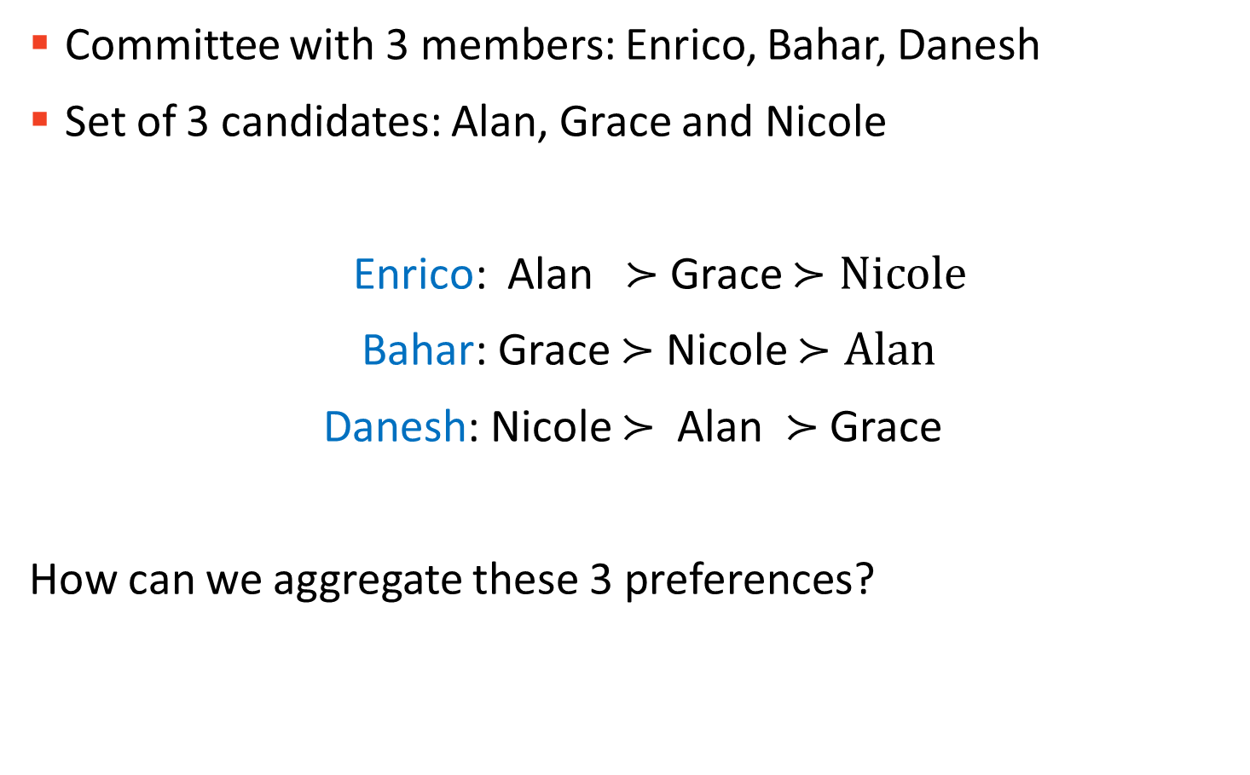
Example
Committee with 3 members: Enrico, Bahar, Danesh
Set of 3 candidates: Alan, Grace and Nicole
Enrico: Alan $≻$ Grace $≻Nicole$
Bahar: Grace $≻$ Nicole $≻Alan$
Danesh: Nicole $≻$ Alan $≻$ Grace
How can we aggregate these 3 preferences?
But for the rest of this lecture we will assume transitivity!

Slide 11
Preference Uncertainty

Slide 12
But do we always know our preferences?
Learning our preferences is costly
Time
Money
Cognitive cost
Often there are too many outcomes and fully ranking them is too costly and we cannot afford that.
Instead, we invest our budget (could be time, money, cognitive power, … or a combination of them) on partially learning our preferences.
What should our learning strategy be? How do we decide where to spend our elicitation budget?

Slide 13
Preference Elicitation
We start with having some partial information (or none at all) about our preferences.
We learn more about preferences by making some queries.
These queries could be anything, e.g.
What cuisine do you prefer, Indian or Italian?
Which restaurant do you prefer, Lakaz Maman or Pho Vietnam?
Do you prefer strawberries to apples at least as much as you prefer chocolate cake to carrot cake?
Pairwise queries: compare two given outcomes
Interviews: learn as much as possible about the value of an outcome

Slide 14
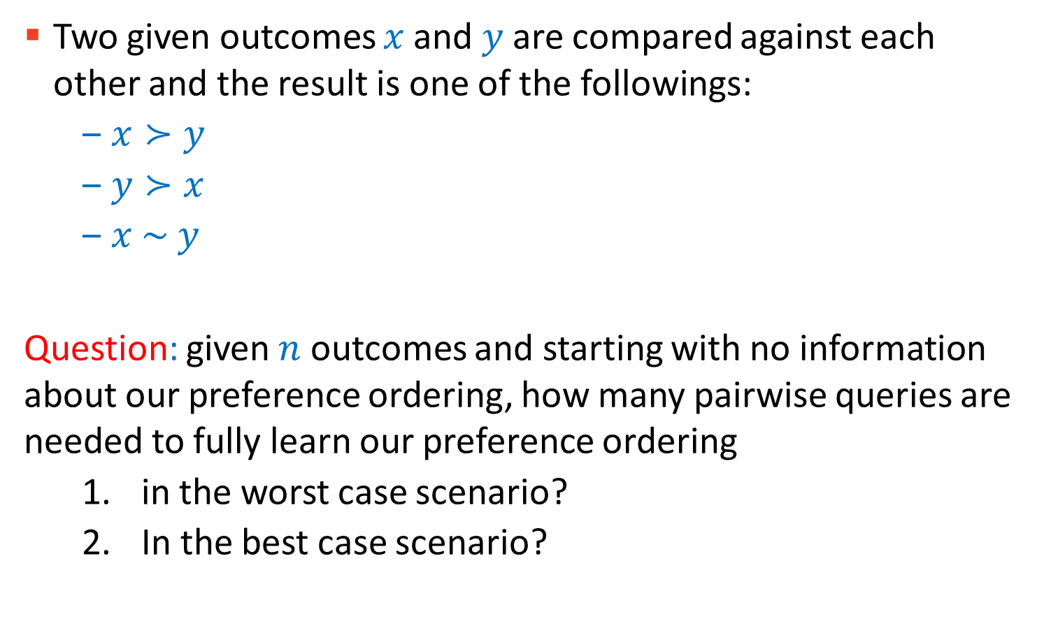
Pairwise Queries
Two given outcomes $x$and $y$ are compared against each other and the result is one of the followings:
$x≻y$
$y≻x$
$x \sim y$
Question: given $n$ outcomes and starting with no information about our preference ordering, how many pairwise queries are needed to fully learn our preference ordering
in the worst case scenario?
In the best case scenario?

Slide 15
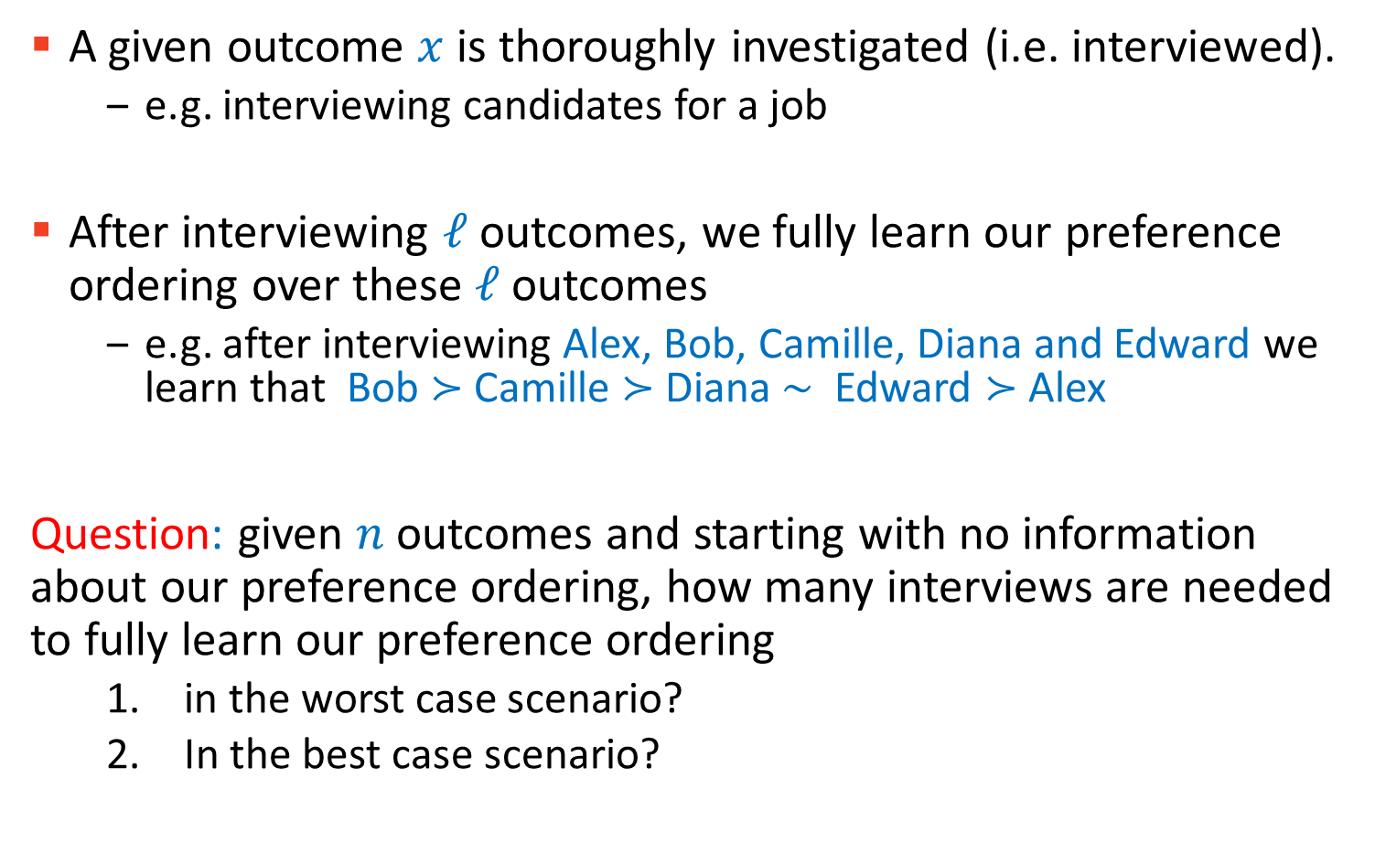
Interviews
A given outcome $x$ is thoroughly investigated (i.e. interviewed).
e.g. interviewing candidates for a job
After interviewing $ℓ$ outcomes, we fully learn our preference ordering over these $ℓ$ outcomes
e.g. after interviewing Alex, Bob, Camille, Diana and Edward we learn that Bob $≻$Camille $≻$Diana ∼ Edward $≻$ Alex
Question: given $n$ outcomes and starting with no information about our preference ordering, how many interviews are needed to fully learn our preference ordering
in the worst case scenario?
In the best case scenario?

Slide 16
Pairwise Queries VS Interviews
Interviews are generally assumed to be way more costly than pairwise comparisons.
In a pairwise queries, we only spend enough effort/time or cognitive cost to compare the given two outcomes.
The choice (of pairwise query or interview) will depend on the application, and sometimes a combination of two is used. Usually,
pairwise comparisons are useful if the two outcomes are sufficiently distinct (or very much the same);
interviews are needed when the outcomes are similar and more information is needed in order to rank them.

Slide 17
Elicitation Scheme/Strategy/Plan
What sort of queries or questions to use (perhaps a combination of few) and in what order?
When to perform elicitation?
An elicitation plan describes when and what to ask.
The plan may depend on the result of the previous questions/queries or other changes to the state of the universe/game.

Slide 18
Example
Five destinations to choose from for a hiking trip: Cornwall, Lake District, Snowdonia, West Highland Way, Dartmoor
No preference information to start with
Eliciting using pairwise comparison
Cornwall ? Lake District
Cornwall ? Snowdonia

Slide 19
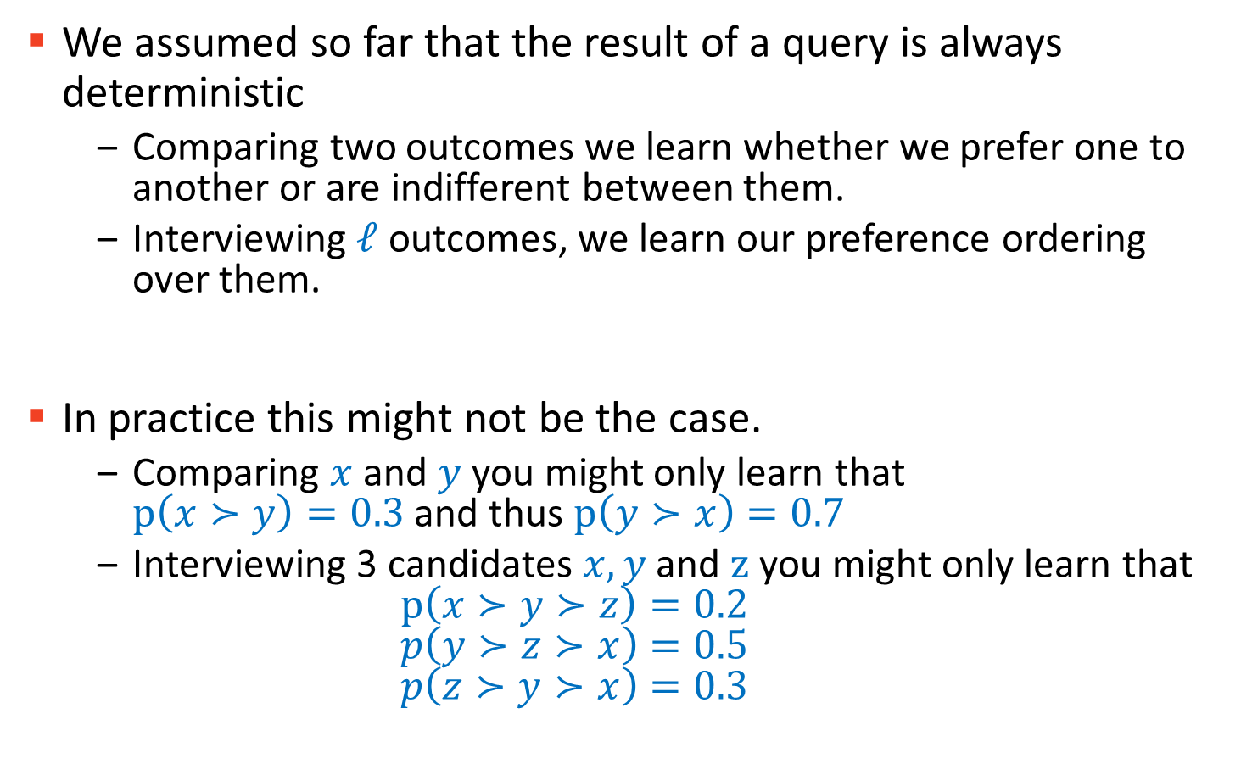
Probabilistic Preferences
We assumed so far that the result of a query is always deterministic
Comparing two outcomes we learn whether we prefer one to another or are indifferent between them.
Interviewing $ℓ$ outcomes, we learn our preference ordering over them.
In practice this might not be the case.
Comparing $x$ and $y$ you might only learn that $p\left(x≻y\right)=0.3$and thus $p\left(y≻x\right)=0.7$
Interviewing 3 candidates $x, y$ and $z$ you might only learn that $p\left(x≻y≻z\right)=0.2$ $p\left(y≻z≻x\right)=0.5$ $p\left(z≻y≻x\right)=0.3$

Slide 20
In the remainder of this lecture (next parts)
We assume that the result of queries are always deterministic.
We only use pairwise queries.
We look at preference elicitation in Multiple Criteria Ranking using Multi-Attribute Additive Utility functions

Slide 21
Preference Elicitation Part 2/3
COMP6203 Intelligent Agents
November 2020
Dr Baharak Rastegari
b.rastegari@soton.ac.uk
Electronics and Computer Science
University of Southampton

Slide 22
Part 2

Slide 23
Learning Outcomes
By the end of this lecture (part 2 and part 3), you should be able to
Define Multi-Criteria Decision Analysis.
Describe ordinal regression.
Describe UTA and UTA^{GMS} methods and their differences.
Compute a compatible value function using UTA method (i.e. write the linear program).
Compute necessary and possible weak preference relations using UTA^{GMS} method (i.e. write the linear programs).

Slide 24
Multi Criteria Ranking using
Multi-Attribute Additive Functions

Slide 25
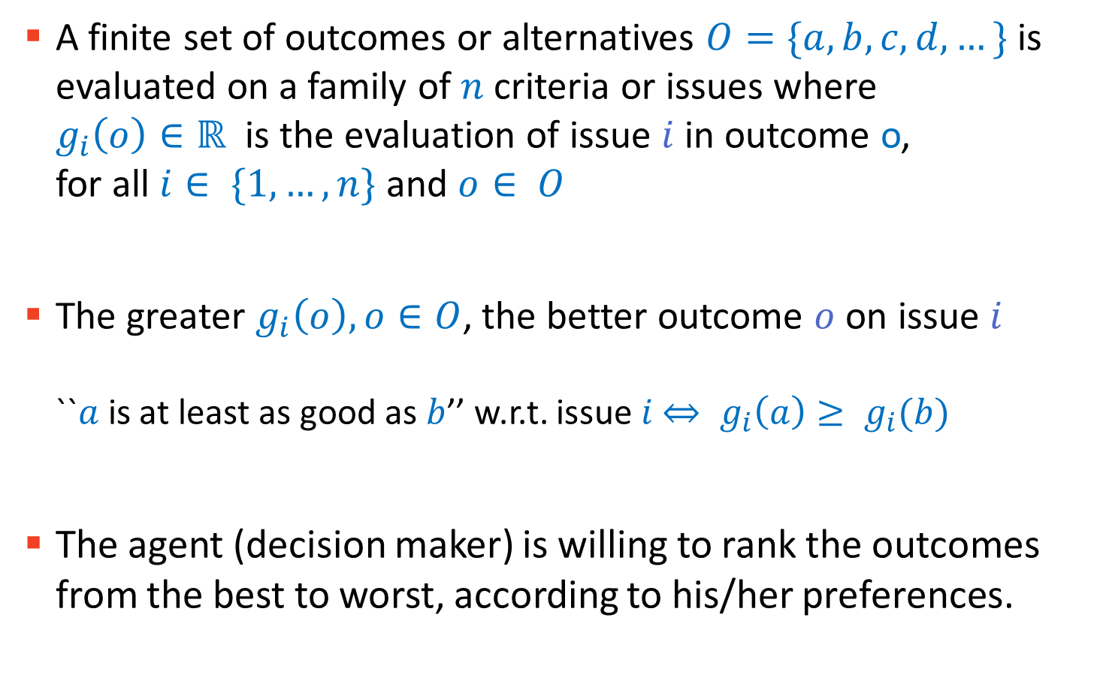
Multi-Criteria Decision Analysis (MCDA)
A finite set of outcomes or alternatives $O=\{a,b,c,d,…\}$ is evaluated on a family of $n$ criteria or issues where $g_{i}\left(o\right)∈ℝ$is the evaluation of issue $i$ in outcome o, for all $i∈ \{1,…,n\}$ and $o∈ O$
The greater $g_{i}\left(o\right), o∈O$, the better outcome $o$ on issue $i$ ``$a$is at least as good as $b$’’ w.r.t. issue $i$ $⇔ g_{i}\left(a\right)≥ g_{i}(b)$
The agent (decision maker) is willing to rank the outcomes from the best to worst, according to his/her preferences.

Slide 26
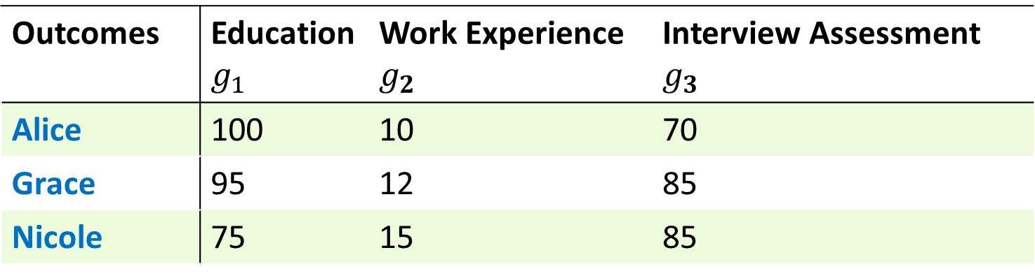
Example
Outcomes | Education $$g_{1}$$ | Work Experience $$g_{2}$$ | Interview Assessment $$g_{3}$$
Alice | 100 | 10 | 70
Grace | 95 | 12 | 85
Nicole | 75 | 15 | 85
Outcomes: Alice, Grace, Nicole
Criteria: i=1 Education, i=2 Work Experience, i=3 Interview Assessment

Slide 27
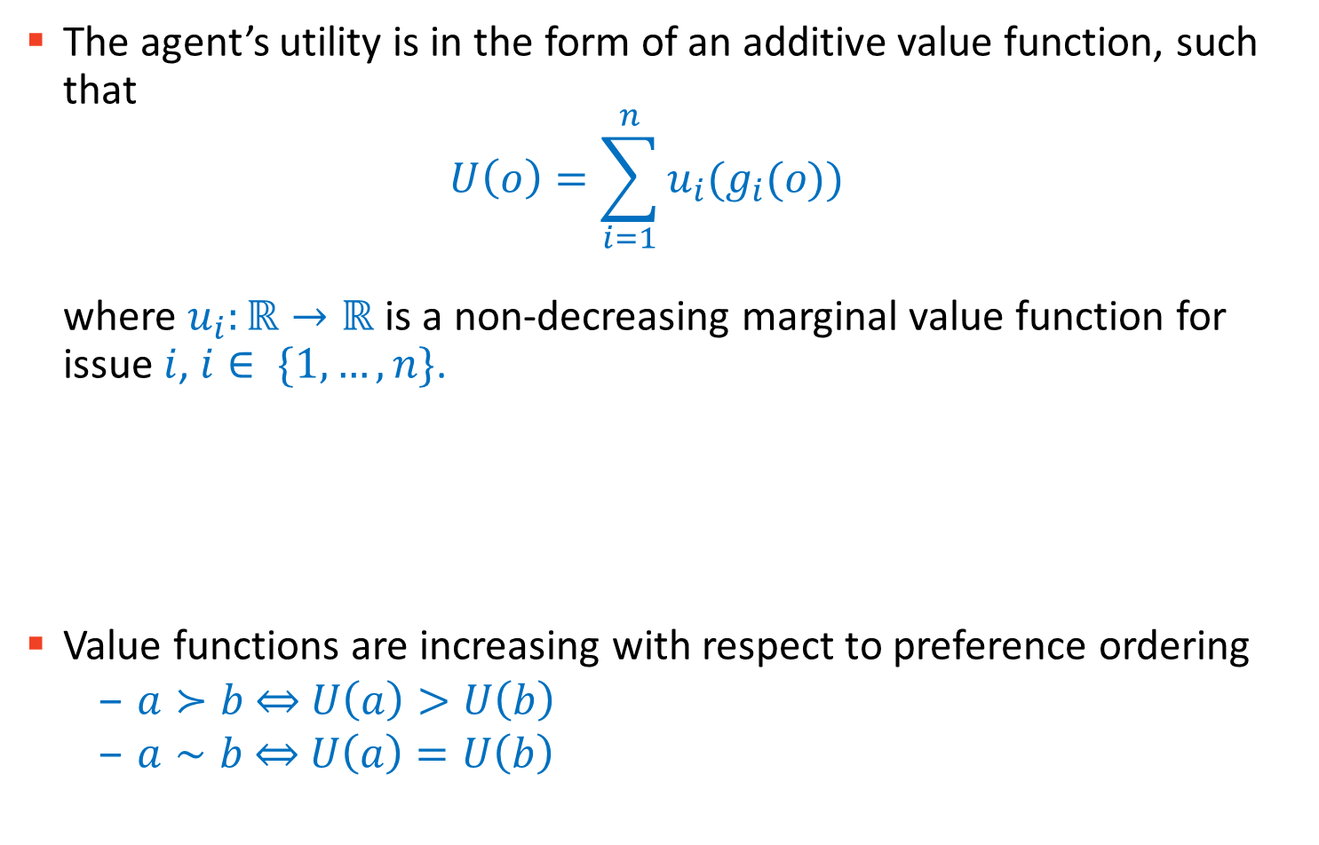
Multi-Attribute Additive Value Functions (MAAVF)
The agent’s utility is in the form of an additive value function, such that $U\left(o\right)=\sum_{i=1}^{n}{u_{i}(g_{i}(o))}$ where $u_{i}:ℝ→ℝ$ is a non-decreasing marginal value function for issue $i$, $i∈ \{1,…,n\}$.
Value functions are increasing with respect to preference ordering
$a≻b$⇔ $U\left(a\right)>U\left(b\right)$
$a∼b$⇔ $U\left(a\right)=U\left(b\right)$
For simplicity I will sometimes write $u_{i}\left(o_{i}\right)$ instead of $u_{i}\left(g_{i}(o)\right).$
N.B. In the rest of the lecture I’m going to refer to $U$’s as (additive) value functions, rather than utility, to be consistent with the terminology used in the related work.

Slide 28
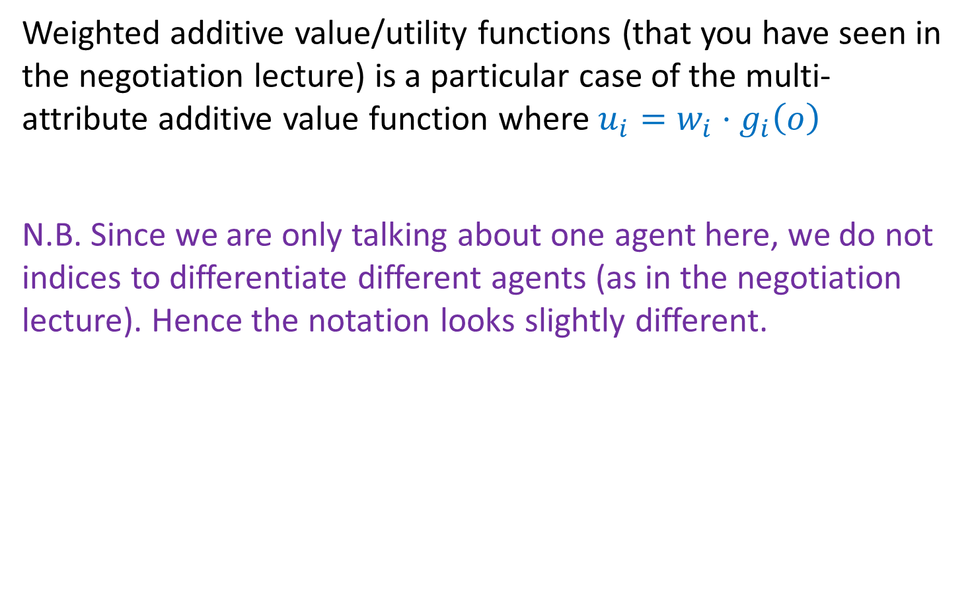
Weighted Additive Value Functions
Weighted additive value/utility functions (that you have seen in the negotiation lecture) is a particular case of the multi-attribute additive value function where $u_{i}=w_{i}⋅g_{i}\left(o\right)$
N.B. Since we are only talking about one agent here, we do not indices to differentiate different agents (as in the negotiation lecture). Hence the notation looks slightly different.

Slide 29
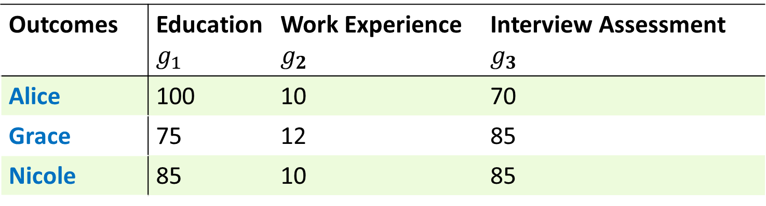
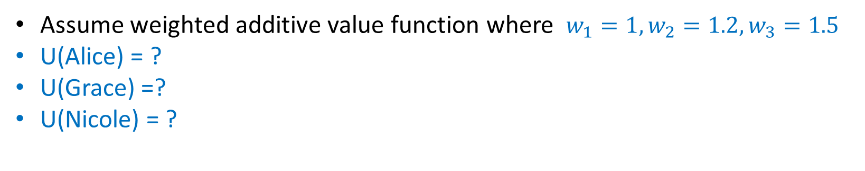
Example
Outcomes | Education $$g_{1}$$ | Work Experience $$g_{2}$$ | Interview Assessment $$g_{3}$$
Alice | 100 | 10 | 70
Grace | 75 | 12 | 85
Nicole | 85 | 10 | 85
Assume weighted additive value function where $w_{1}=1, w_{2}=1.2, w_{3}=1.5$
U(Alice) = ?
U(Grace) =?
U(Nicole) = ?
Notes:
217, 216.9, 224.5

Slide 30
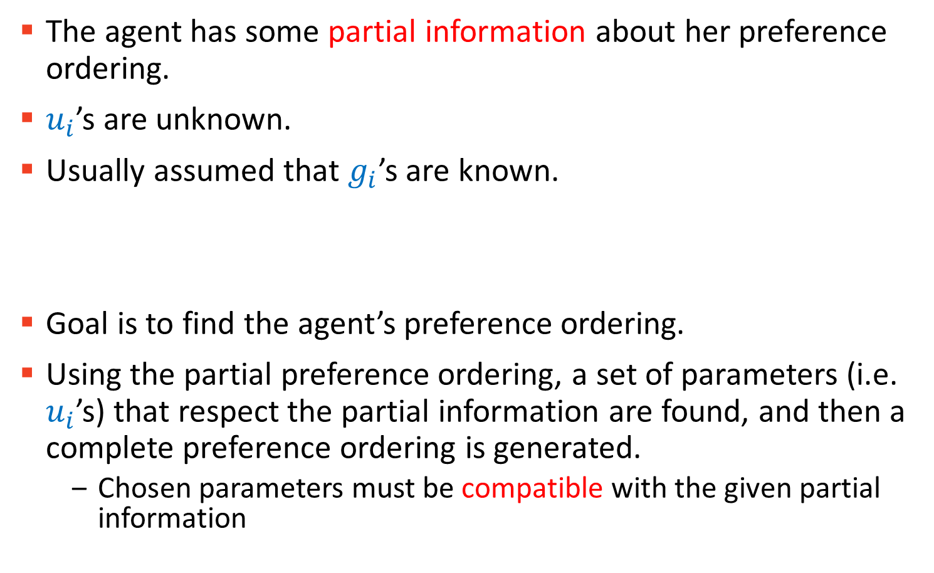
Ordinal Regression
The agent has some partial information about her preference ordering.
$u_{i}$’s are unknown.
Usually assumed that $g_{i}$’s are known.
Goal is to find the agent’s preference ordering.
Using the partial preference ordering, a set of parameters (i.e. $u_{i}$’s) that respect the partial information are found, and then a complete preference ordering is generated.
Chosen parameters must be compatible with the given partial information

Slide 31
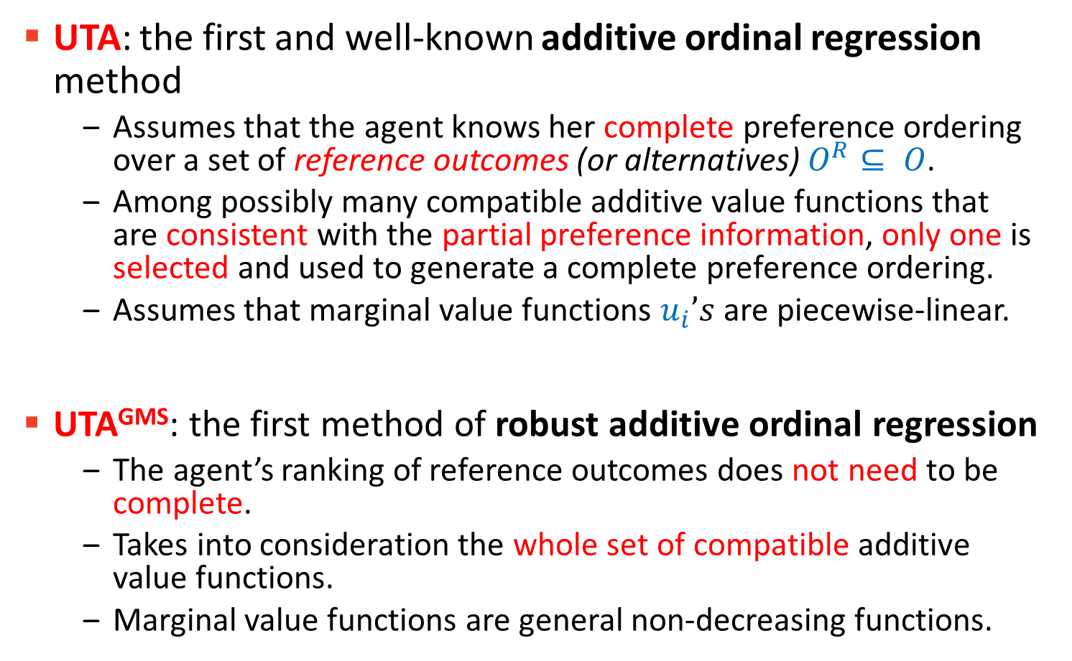
In the Rest of the Lecture
UTA: the first and well-known additive ordinal regression method
Assumes that the agent knows her complete preference ordering over a set of reference outcomes (or alternatives) $O^{R}⊆ O$.
Among possibly many compatible additive value functions that are consistent with the partial preference information, only one is selected and used to generate a complete preference ordering.
Assumes that marginal value functions $u_{i}’s$are piecewise-linear.
UTA^{GMS}: the first method of robust additive ordinal regression
The agent’s ranking of reference outcomes does not need to be complete.
Takes into consideration the whole set of compatible additive value functions.
Marginal value functions are general non-decreasing functions.

Slide 32
Ordinal Regression via Linear Programming – principle of the UTA method

Slide 33
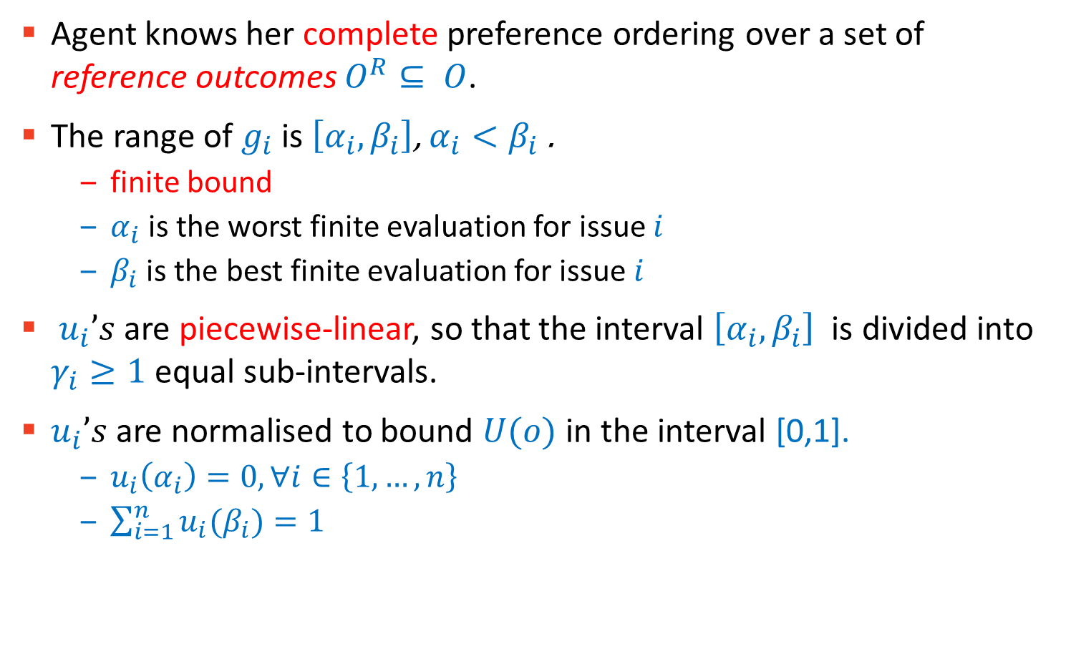
Assumptions
Agent knows her complete preference ordering over a set of reference outcomes $O^{R}⊆ O$.
The range of $g_{i}$ is $\left[α_{i}, β_{i}\right]$, $α_{i}<β_{i}$ .
finite bound
$α_{i}$is the worst finite evaluation for issue $i$
$β_{i}$ is the best finite evaluation for issue $i$
$u_{i}’s$are piecewise-linear, so that the interval $\left[α_{i}, β_{i}\right]$ is divided into $γ_{i}≥1$ equal sub-intervals.
$u_{i}’s$are normalised to bound $U(o)$in the interval [0,1].
$u_{i}\left(α_{i}\right)=0, ∀i∈\left\{1,…,n\right\}$
$\sum_{i=1}^{n}{u_{i}(β_{i})}=1$

Slide 34
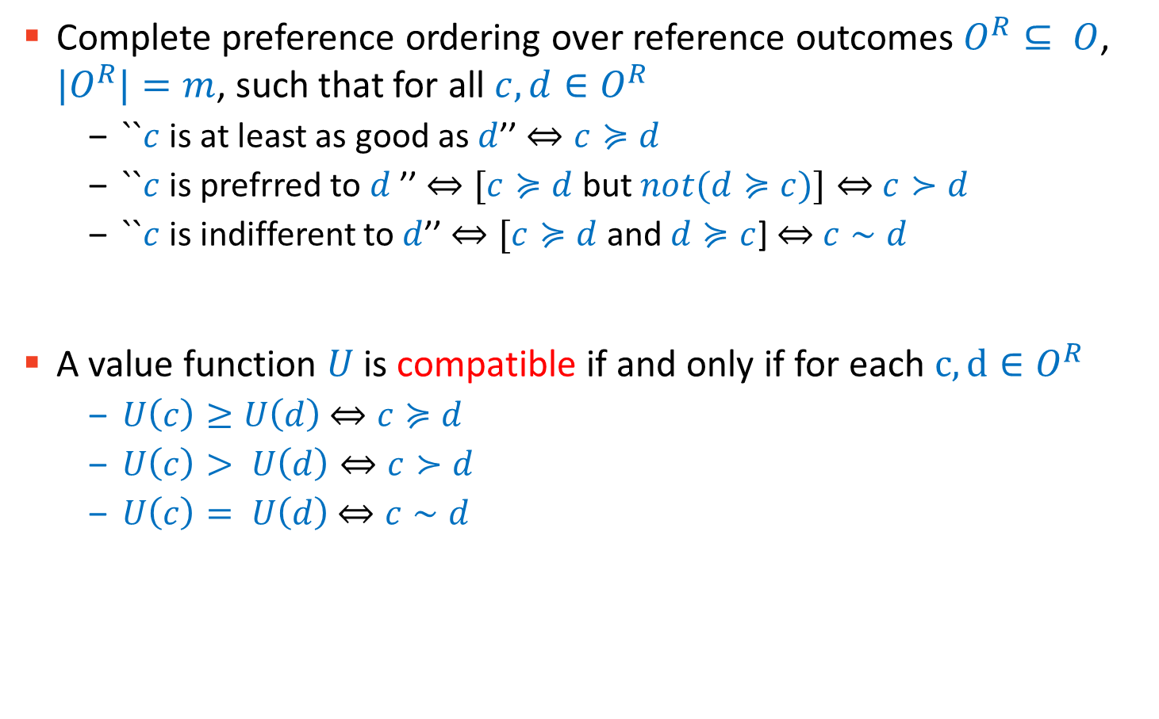
Reference Outcomes
Complete preference ordering over reference outcomes $O^{R}⊆ O$, ${|O}^{R}|=m$, such that for all $c,d∈O^{R}$
$``c$is at least as good as $d$’’ $⇔c≽d$
$``c$is prefrred to $d$ ’’ $⇔[c≽d$ but $not(d≽c)]⇔$ $c≻d$
$``c$is indifferent to $d$’’ $⇔[c≽d$ and $d≽c$] $⇔$ $c∼d$
A value function $U$ is compatible if and only if for each $c, d∈O^{R}$
$U\left(c\right)≥U\left(d\right)$ $⇔c≽d$
$U\left(c\right)> U\left(d\right)⇔c≻d$
$U\left(c\right)= U\left(d\right)$ $⇔c∼d$

Slide 35
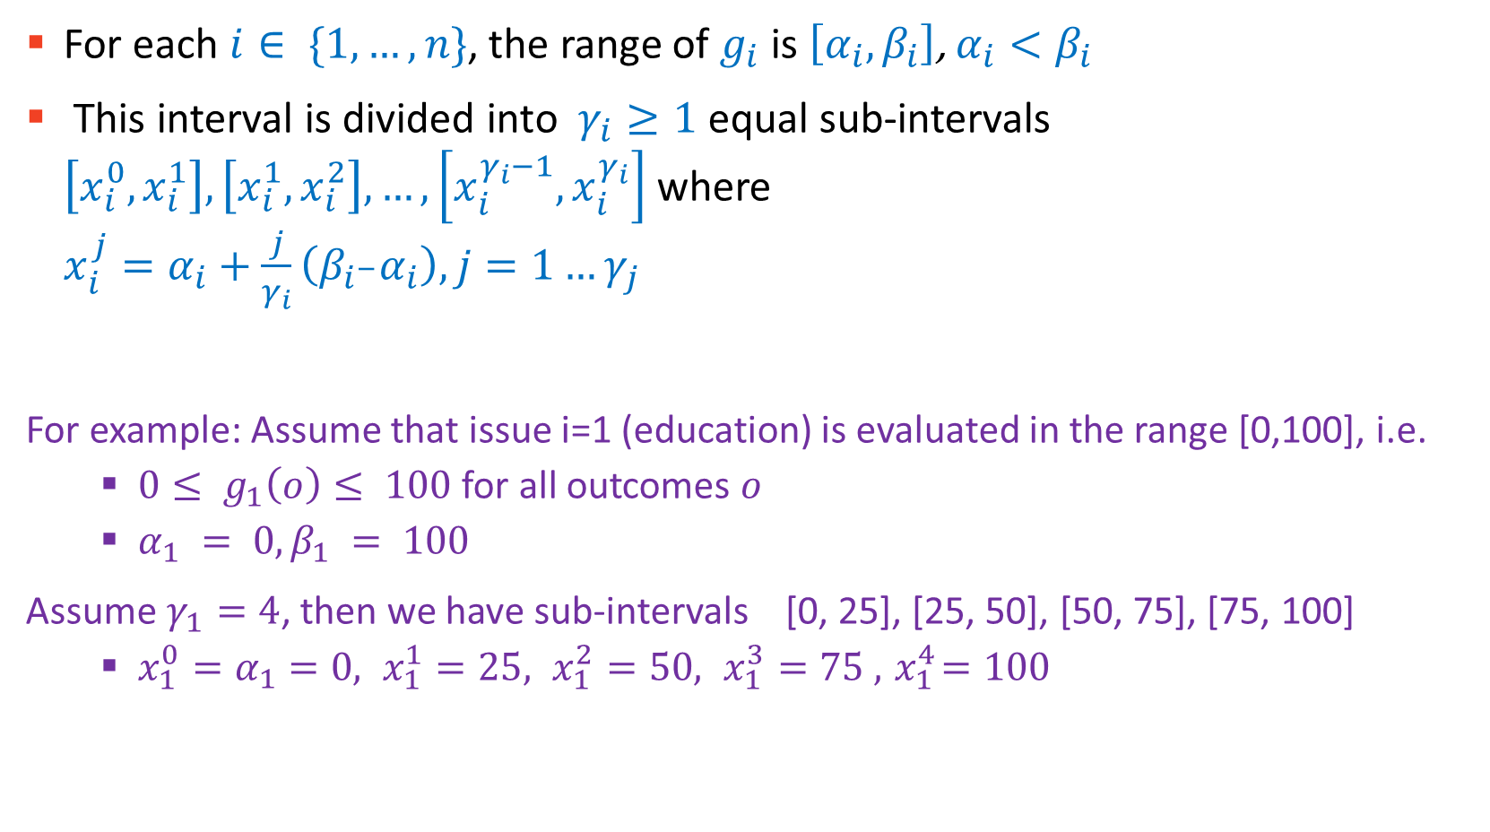
Piece-Wise Linear Marginal Value Functions
For each $i∈ \{1,…,n\}$, the range of $g_{i}$ is $\left[α_{i}, β_{i}\right]$, $α_{i}<β_{i}$
This interval is divided into $γ_{i}≥1$ equal sub-intervals $\left[x_{i}^{0}, x_{i}^{1}\right], \left[x_{i}^{1},x_{i}^{2}\right],…, \left[x_{i}^{γ_{i}−1}, x_{i}^{γ_{i}}\right]$ where $x_{i}^{j}=α_{i}+\frac{j}{γ_{i}}\left(β_{i^{−}}α_{i}\right), j=1…γ_{j}$
For example: Assume that issue i=1 (education) is evaluated in the range [0,100], i.e.
$0≤ g_{1}\left(o\right)≤ 100$for all outcomes $o$
$α_{1} = 0, β_{1} = 100$
Assume$γ_{1}=4$, then we have sub-intervals [0, 25], [25, 50], [50, 75], [75, 100]
$x_{1}^{0}=α_{1}=0, x_{1}^{1}=25, x_{1}^{2}=50, x_{1}^{3}=75 , { x}_{1}^{4}=100$

Slide 36
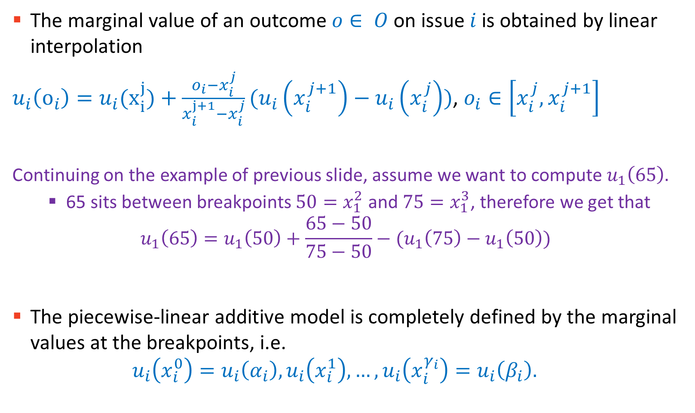
Piece-Wise Linear Marginal Value Functions
The marginal value of an outcome $o∈ O$on issue $i$ is obtained by linear interpolation
$u_{i}\left(o_{i}\right)=u_{i}(x_{i}^{j})+\frac{o_{i}−x_{i}^{j}}{x_{i}^{j+1}−x_{i}^{j}}(u_{i}\left(x_{i}^{j+1}\right)−u_{i}\left(x_{i}^{j}\right))$, $o_{i}∈\left[x_{i}^{j}, x_{i}^{j+1}\right]$
Continuing on the example of previous slide, assume we want to compute $u_{1}\left(65\right).$
65 sits between breakpoints $50=x_{1}^{2}$ and $75=x_{1}^{3}$, therefore we get that
$$u_{1}\left(65\right)=u_{1}\left(50\right)+\frac{65−50}{75−50}−(u_{1}\left(75\right)−u_{1}\left(50\right))$$
The piecewise-linear additive model is completely defined by the marginal values at the breakpoints, i.e. $u_{i}\left(x_{i}^{0}\right)=u_{i}\left(α_{i}\right), u_{i}\left(x_{i}^{1}\right), …, u_{i}\left(x_{i}^{γ_{i}}\right)=u_{i}\left(β_{i}\right).$

Slide 37
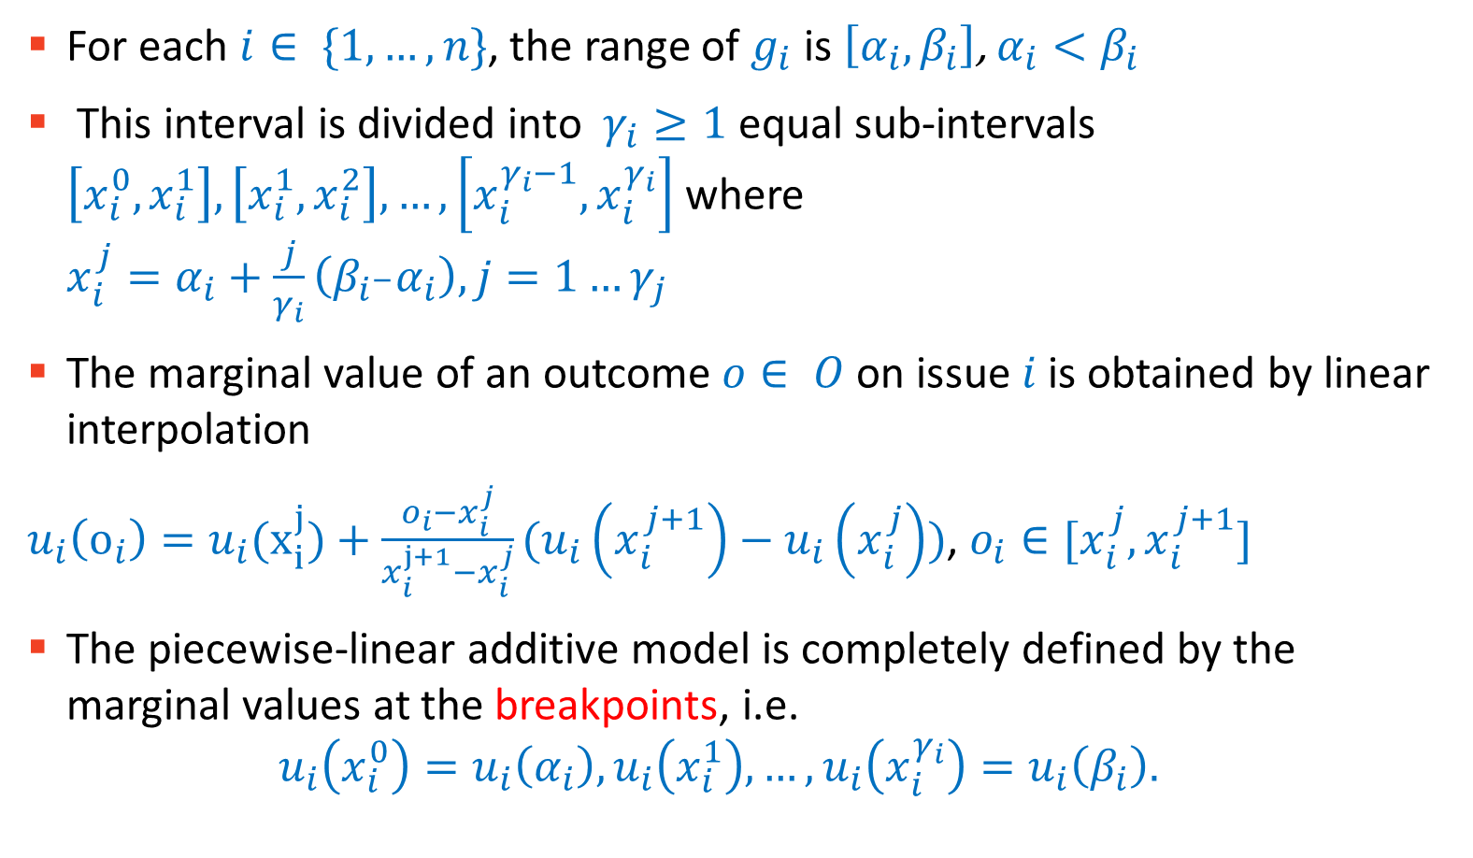
Piece-Wise Linear Marginal Value Functions
For each $i∈ \{1,…,n\}$, the range of $g_{i}$ is $\left[α_{i}, β_{i}\right]$, $α_{i}<β_{i}$
This interval is divided into $γ_{i}≥1$ equal sub-intervals $\left[x_{i}^{0}, x_{i}^{1}\right], \left[x_{i}^{1},x_{i}^{2}\right],…, \left[x_{i}^{γ_{i}−1}, x_{i}^{γ_{i}}\right]$ where $x_{i}^{j}=α_{i}+\frac{j}{γ_{i}}\left(β_{i^{−}}α_{i}\right), j=1…γ_{j}$
The marginal value of an outcome $o∈ O$on issue $i$ is obtained by linear interpolation
$u_{i}\left(o_{i}\right)=u_{i}(x_{i}^{j})+\frac{o_{i}−x_{i}^{j}}{x_{i}^{j+1}−x_{i}^{j}}(u_{i}\left(x_{i}^{j+1}\right)−u_{i}\left(x_{i}^{j}\right))$, $o_{i}∈[x_{i}^{j}, x_{i}^{j+1}]$
The piecewise-linear additive model is completely defined by the marginal values at the breakpoints, i.e. $u_{i}\left(x_{i}^{0}\right)=u_{i}\left(α_{i}\right), u_{i}\left(x_{i}^{1}\right), …, u_{i}\left(x_{i}^{γ_{i}}\right)=u_{i}\left(β_{i}\right).$

Slide 38

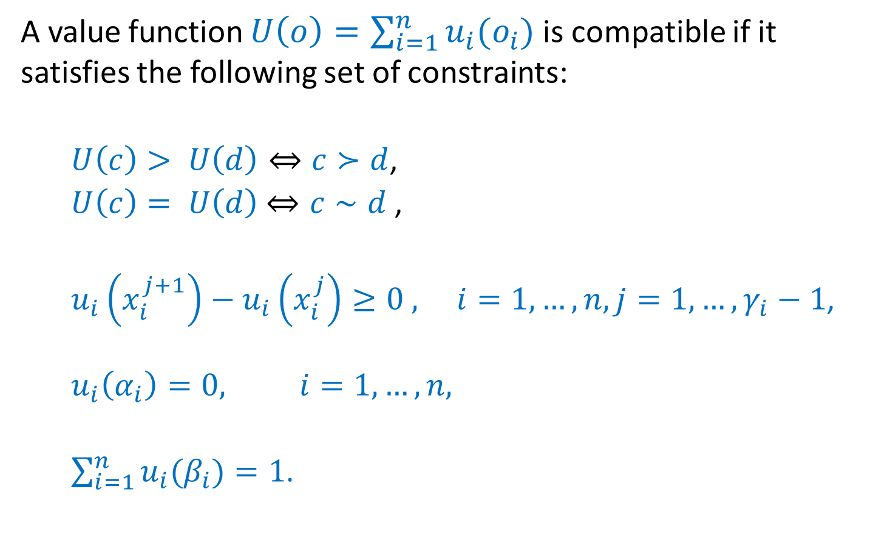
Constraints for a Compatible Value Function
A value function $U\left(o\right)=\sum_{i=1}^{n}{u_{i}(o_{i})}$is compatible if it satisfies the following set of constraints:
$U\left(c\right)> U\left(d\right)⇔c≻d$,
$U\left(c\right)= U\left(d\right)$ $⇔c∼d$ ,
$u_{i}\left(x_{i}^{j+1}\right)−u_{i}\left(x_{i}^{j}\right)≥0 , i=1, …, n, j=1, …, γ_{i}−1$,
$$u_{i}\left(α_{i}\right)=0, i=1,…,n,$$
$\sum_{i=1}^{n}{u_{i}(β_{i})=1}$.
$$∀c,d∈O^{R},$$

Slide 39
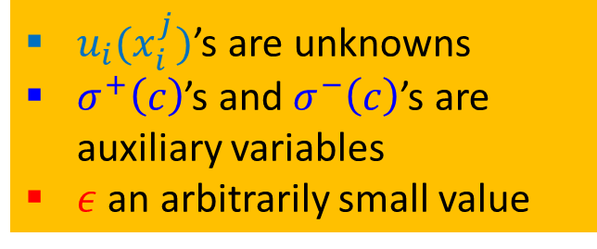
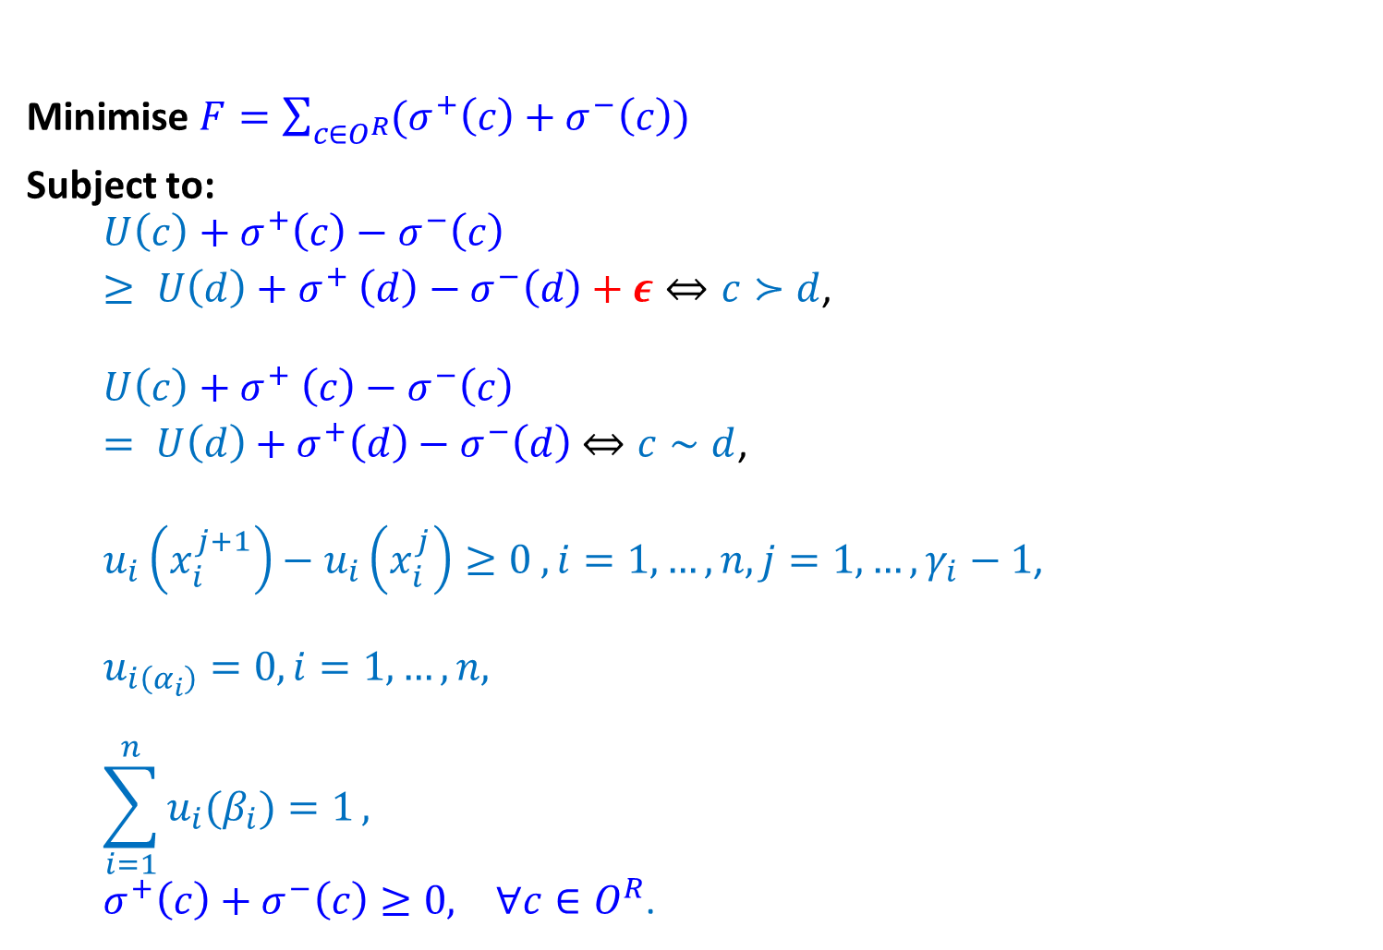


Linear Program
Minimise $F=\sum_{c∈O^{R}}{(σ^{+}\left(c\right)+σ^{−}\left(c\right))}$
Subject to:
$$U\left(c\right)+σ^{+}\left(c\right)−σ^{−}\left(c\right)$$ $≥ U\left(d\right){+ σ}^{+}\left(d\right)−σ^{−}\left(d\right)+ε⇔c≻d$,
$$U\left(c\right){+ σ}^{+}\left(c\right)−σ^{−}\left(c\right)$$ $= U\left(d\right)$ ${+ σ}^{+}\left(d\right)−σ^{−}\left(d\right)$ $⇔c∼d$,
$u_{i}\left(x_{i}^{j+1}\right)−u_{i}\left(x_{i}^{j}\right)≥0 , i=1, …, n, j=1, …, γ_{i}−1$,
$$u_{i\left(α_{i}\right)}=0, i=1,…,n,$$
$$\sum_{i=1}^{n}{u_{i}(β_{i})=1},$$
$σ^{+}\left(c\right)+σ^{−}\left(c\right)≥0, ∀c∈O^{R}$.
$$∀c,d∈O^{R},$$
$u_{i}(x_{i}^{j})$’s are unknowns
$σ^{+}\left(c\right)$’s and $σ^{−}\left(c\right)$’s are auxiliary variables
$ε$ an arbitrarily small value

Slide 40
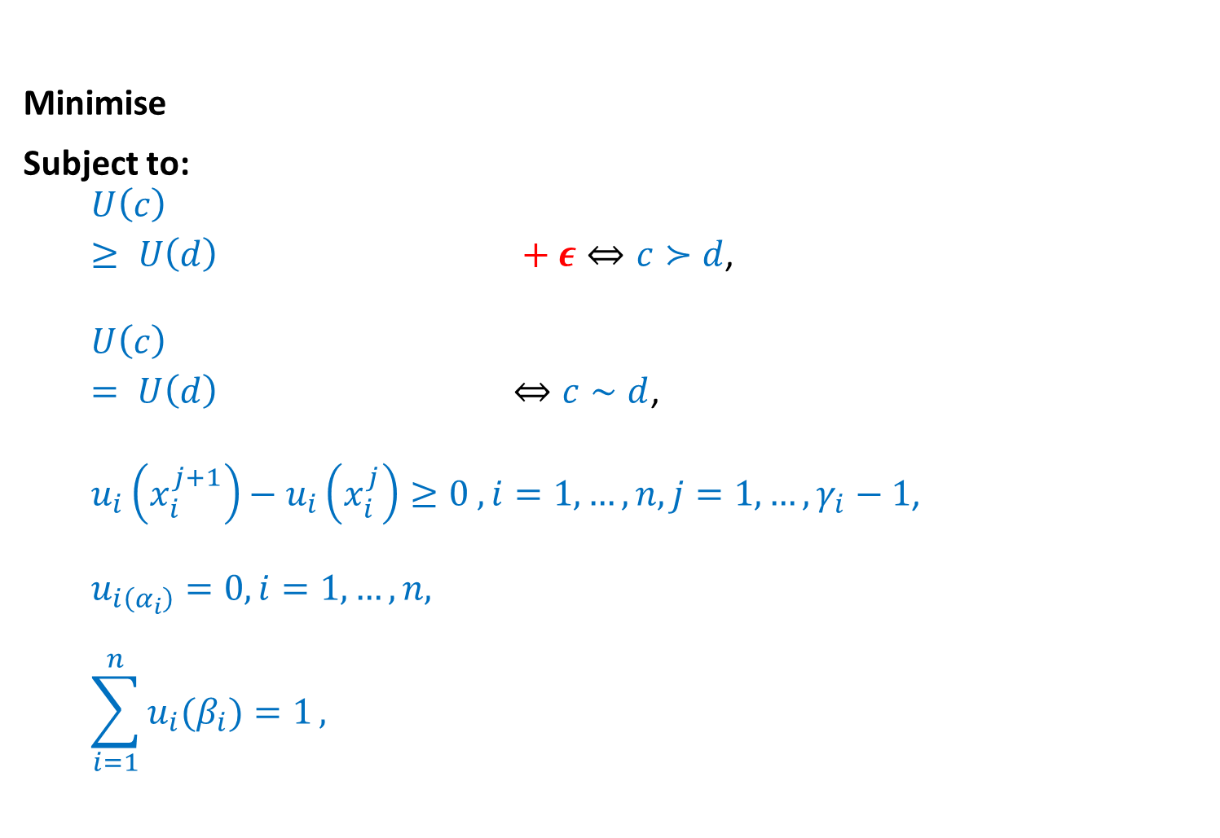

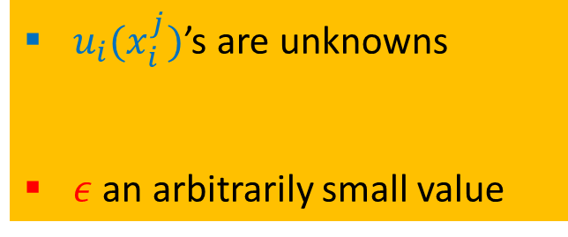
Linear Program without $σ$’s
Minimise $F=\sum_{c∈O^{R}}{(σ^{+}\left(c\right)+σ^{−}\left(c\right))}$
Subject to:
$$U\left(c\right)+σ^{+}\left(c\right)−σ^{−}\left(c\right)$$ $≥ U\left(d\right){+ σ}^{+}\left(d\right)−σ^{−}\left(d\right)+ε⇔c≻d$,
$$U\left(c\right){+ σ}^{+}\left(c\right)−σ^{−}\left(c\right)$$ $= U\left(d\right)$ ${+ σ}^{+}\left(d\right)−σ^{−}\left(d\right)$ $⇔c∼d$,
$u_{i}\left(x_{i}^{j+1}\right)−u_{i}\left(x_{i}^{j}\right)≥0 , i=1, …, n, j=1, …, γ_{i}−1$,
$$u_{i\left(α_{i}\right)}=0, i=1,…,n,$$
$$\sum_{i=1}^{n}{u_{i}(β_{i})=1},$$
$σ^{+}\left(c\right)+σ^{−}\left(c\right)≥0, ∀c∈O^{R}$.
$$∀c,d∈O^{R},$$
$u_{i}(x_{i}^{j})$’s are unknowns
$σ^{+}\left(a_{k}\right)$’s and $σ^{−}\left(a_{k}\right)$’s are auxiliary variables
$ε$ an arbitrarily small value

Slide 41
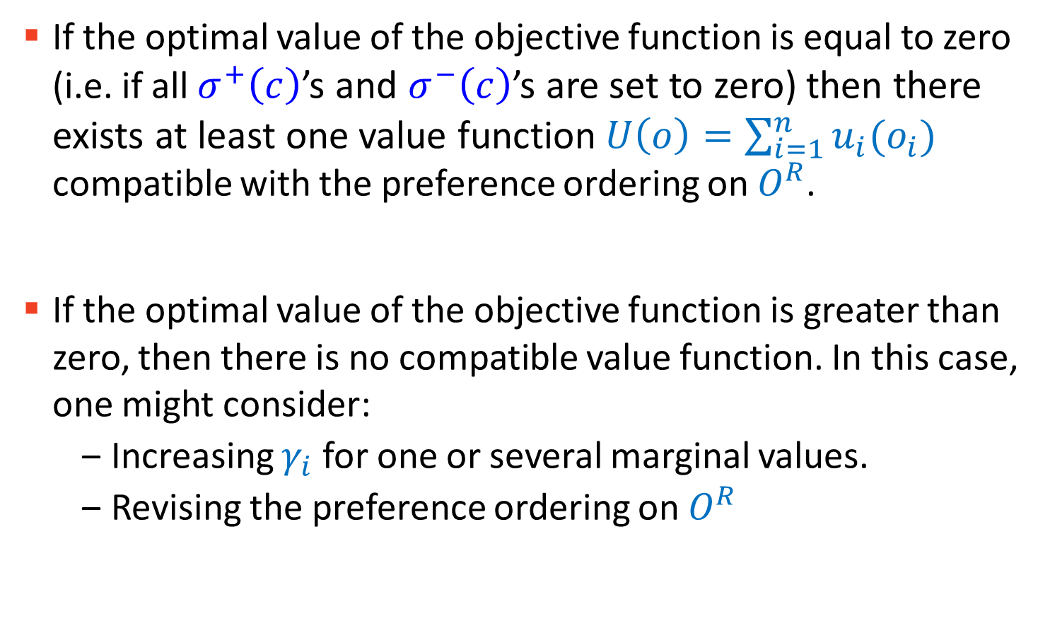
Solution or No Solution
If the optimal value of the objective function is equal to zero (i.e. if all $σ^{+}\left(c\right)$’s and $σ^{−}\left(c\right)$’s are set to zero) then there exists at least one value function$U\left(o\right)=\sum_{i=1}^{n}{u_{i}(o_{i})}$ compatible with the preference ordering on $O^{R}$.
If the optimal value of the objective function is greater than zero, then there is no compatible value function. In this case, one might consider:
Increasing $γ_{i}$ for one or several marginal values.
Revising the preference ordering on $O^{R}$

Slide 42
Preference Elicitation Part 3/3
COMP6203 Intelligent Agents
November 2020
Dr Baharak Rastegari
b.rastegari@soton.ac.uk
Electronics and Computer Science
University of Southampton

Slide 43
Part 3

Slide 44
UTA^{GMS}
– Robust Ordinal Regression

Slide 45
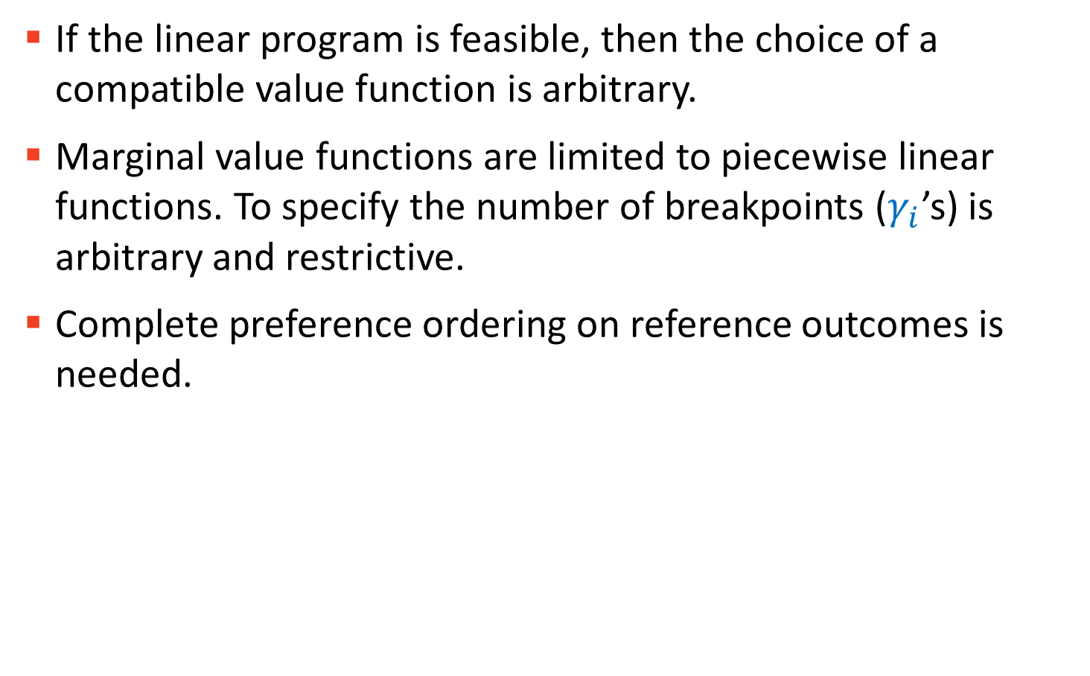
Limitations of UTA
If the linear program is feasible, then the choice of a compatible value function is arbitrary.
Marginal value functions are limited to piecewise linear functions. To specify the number of breakpoints ($γ_{i}$’s) is arbitrary and restrictive.
Complete preference ordering on reference outcomes is needed.

Slide 46
UTA^{GMS}
Takes into consideration the whole set of compatible additive value functions.
Marginal value functions are general non-decreasing functions.
The agent’s ranking of reference outcomes does not need to be complete.

Slide 47
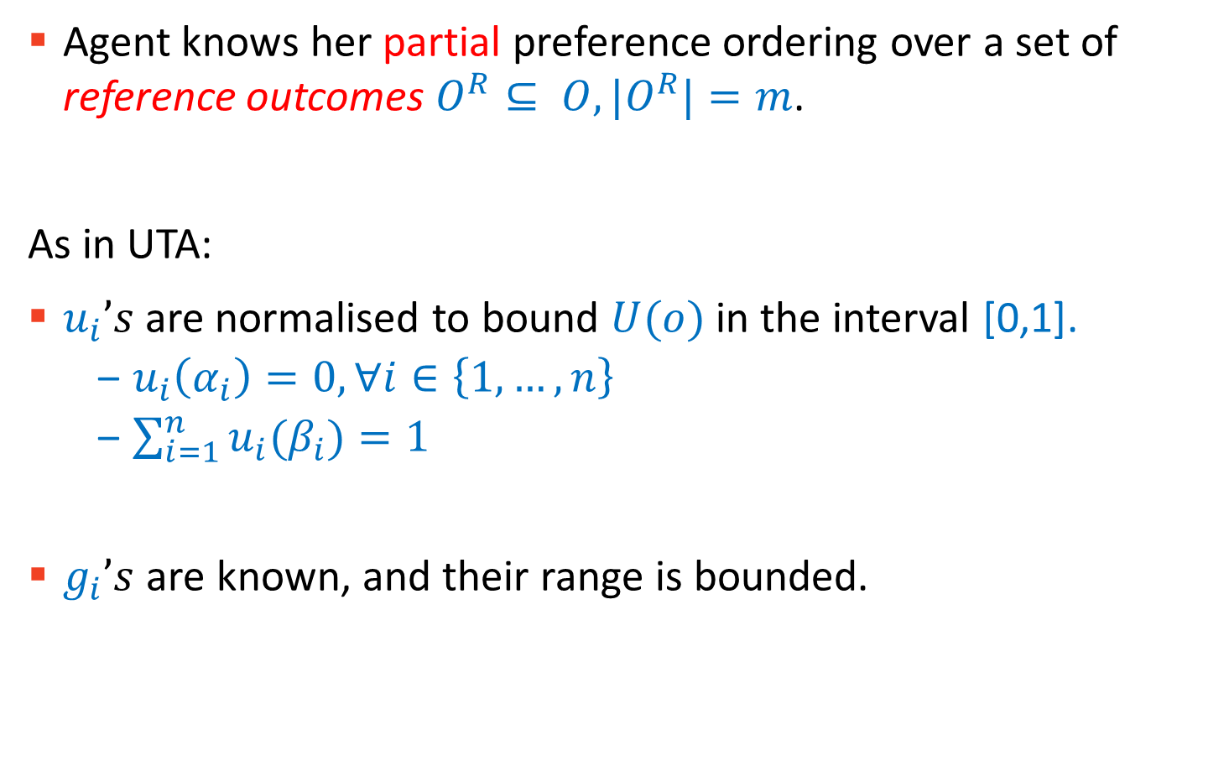
Assumptions
Agent knows her partial preference ordering over a set of reference outcomes $O^{R}⊆ O, |O^{R}|=m$.
As in UTA:
$u_{i}’s$are normalised to bound $U(o)$in the interval [0,1].
$u_{i}\left(α_{i}\right)=0, ∀i∈\left\{1,…,n\right\}$
$\sum_{i=1}^{n}{u_{i}(β_{i})}=1$
$g_{i}’s$ are known, and their range is bounded.

Slide 48
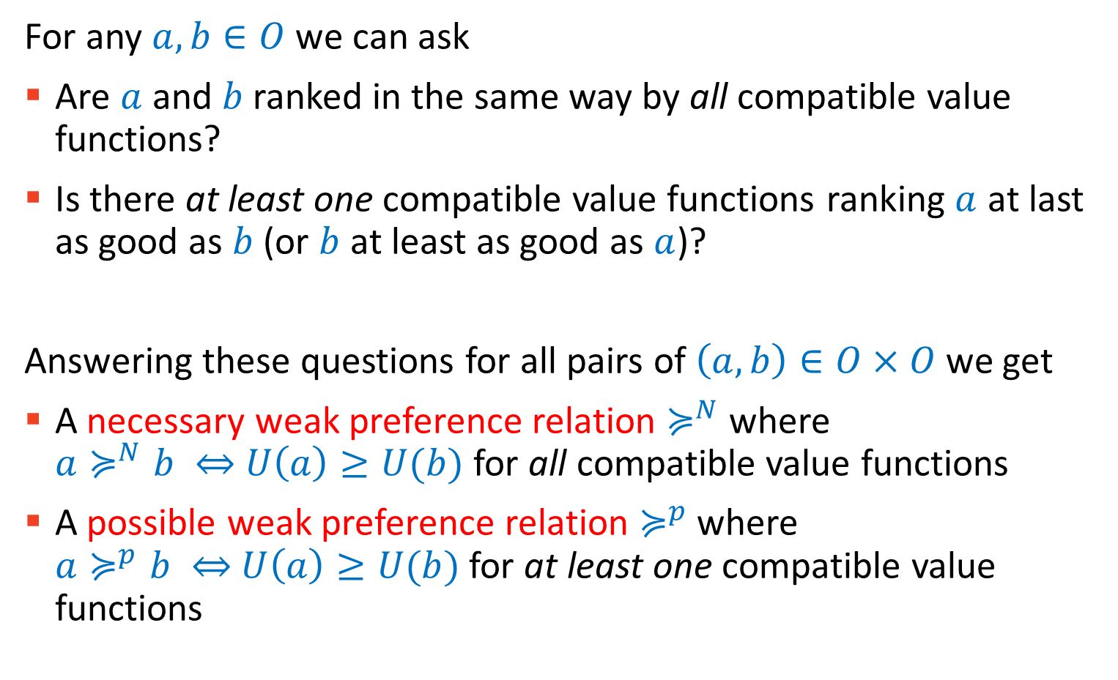

Necessary and Possible weak preference relations
For any $a, b∈O$we can ask
Are $a$ and $b$ ranked in the same way by all compatible value functions?
Is there at least one compatible value functions ranking $a$ at last as good as $b$ (or $b$ at least as good as $a$)?
Answering these questions for all pairs of $\left(a,b\right)∈O×O$we get
A necessary weak preference relation $≽^{N}$ where $a≽^{N}b ⇔$ $U\left(a\right)≥U(b)$for all compatible value functions
A possible weak preference relation $≽^{p}$ where $a≽^{p}b ⇔$ $U\left(a\right)≥U(b)$for at least one compatible value functions

Slide 49

From Partial Preference Ordering
For any $a, b∈O^{R}$
If $a≽b ⇒a≽^{N}b$
If $a≻b ⇒not(b≽^{p}a)$

Slide 50

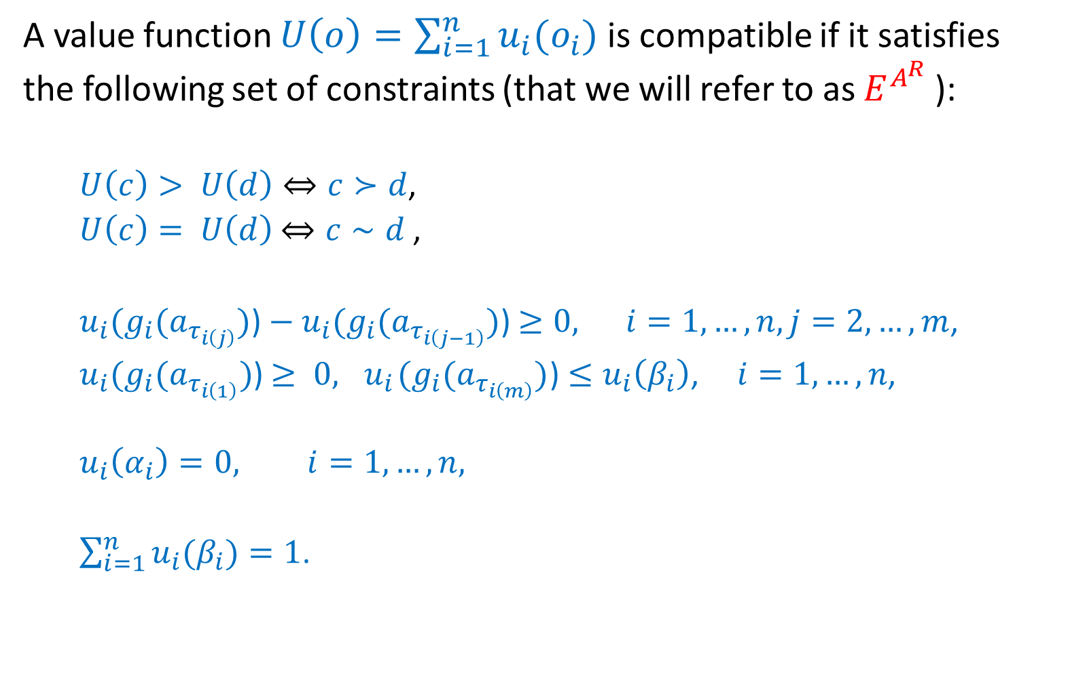
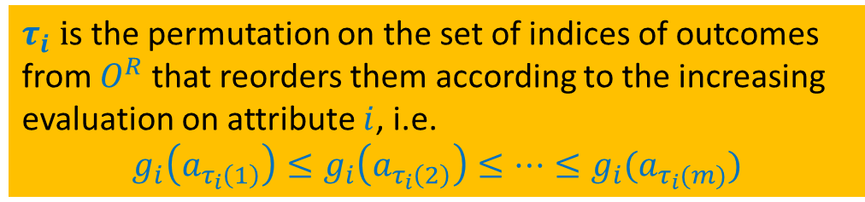
Constraints for a Compatible Value Function
A value function $U\left(o\right)=\sum_{i=1}^{n}{u_{i}(o_{i})}$is compatible if it satisfies the following set of constraints (that we will refer to as $E^{A^{R}}$):
$U\left(c\right)> U\left(d\right)⇔c≻d$,
$U\left(c\right)= U\left(d\right)$ $⇔c∼d$ ,
$u_{i}(g_{i}(a_{τ_{i\left(j\right)}})$)${− u}_{i}(g_{i}(a_{τ_{i\left(j−1\right)}})$) $≥0, i=1,…,n, j=2,…,m$,
$u_{i}(g_{i}(a_{τ_{i\left(1\right)}})$) $≥ 0, { u}_{i}(g_{i}(a_{τ_{i\left(m\right)}})$) $≤u_{i}\left(β_{i}\right)$, $i=1,…,n$,
$$u_{i}\left(α_{i}\right)=0, i=1,…,n,$$
$\sum_{i=1}^{n}{u_{i}(β_{i})=1}$.
$$∀c,d∈O^{R}$$
$τ_{i} i$s the permutation on the set of indices of outcomes from $O^{R}$that reorders them according to the increasing evaluation on attribute $i$, i.e.
$$g_{i}\left(a_{τ_{i}\left(1\right)}\right)≤g_{i}\left(a_{τ_{i}\left(2\right)}\right)≤…≤g_{i}(a_{τ_{i}(m)})$$

Slide 51
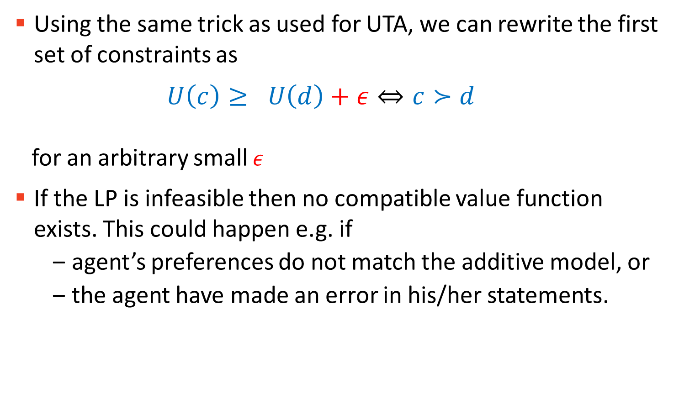

Turning $E^{A^{R}}$into a Linear Program
Using the same trick as used for UTA, we can rewrite the first set of constraints as
$U\left(c\right)≥ U\left(d\right)+ε⇔c≻d$ for an arbitrary small $ε$
If the LP is infeasible then no compatible value function exists. This could happen e.g. if
agent’s preferences do not match the additive model, or
the agent have made an error in his/her statements.

Slide 52

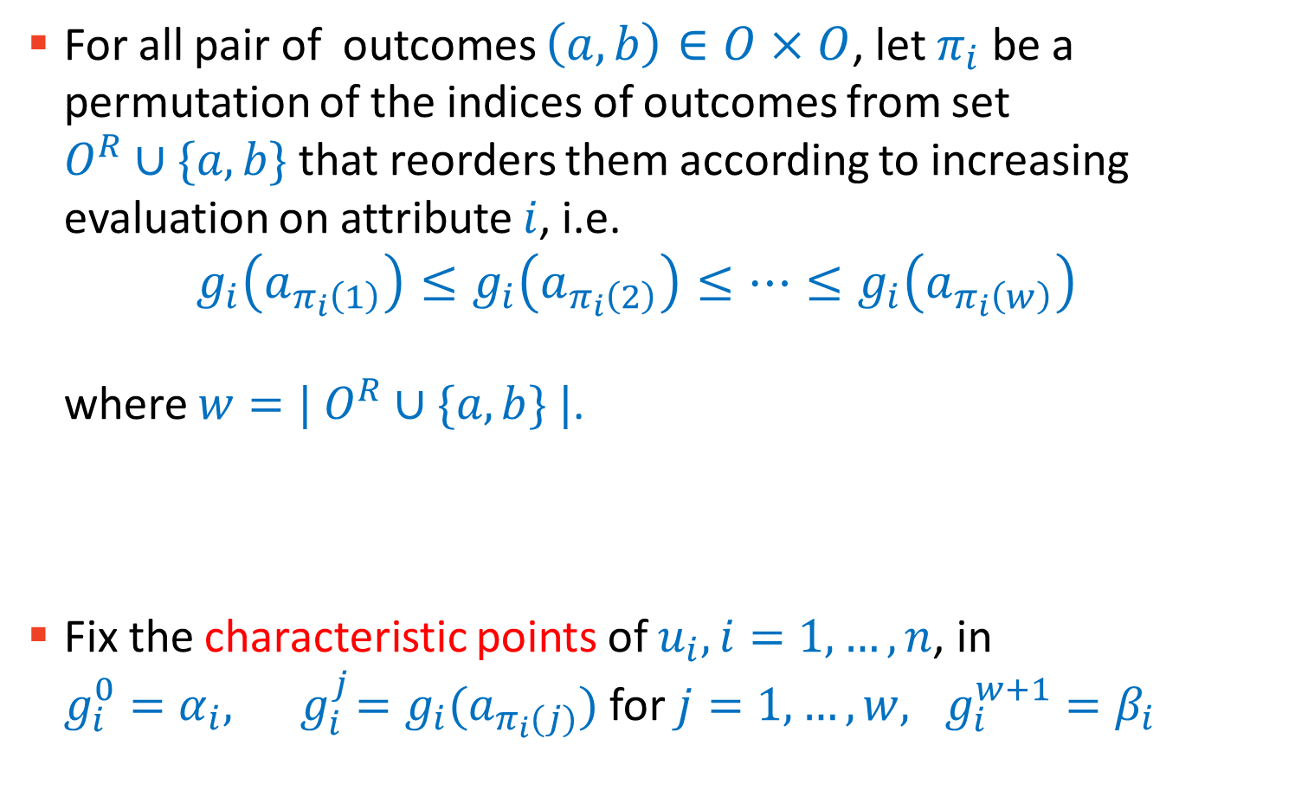
Computation of $≽^{N}$ and $≽^{P}$
For all pair of outcomes $\left(a,b\right)∈O×O$, let $π_{i}$ be a permutation of the indices of outcomes from set $O^{R}∪\{a,b\}$that reorders them according to increasing evaluation on attribute $i$, i.e. $g_{i}\left(a_{π_{i}\left(1\right)}\right)≤g_{i}\left(a_{π_{i}\left(2\right)}\right)≤…≤g_{i}\left(a_{π_{i}\left(w\right)}\right)$ where $w=| O^{R}∪\{a,b\} |$.
Fix the characteristic points of $u_{i}, i=1,…,n$, in $g_{i}^{0}=α_{i}, { g}_{i}^{j}=g_{i}(a_{π_{i}(j)})$ for $j=1,…,w, g_{i}^{w+1}=β_{i}$

Slide 53
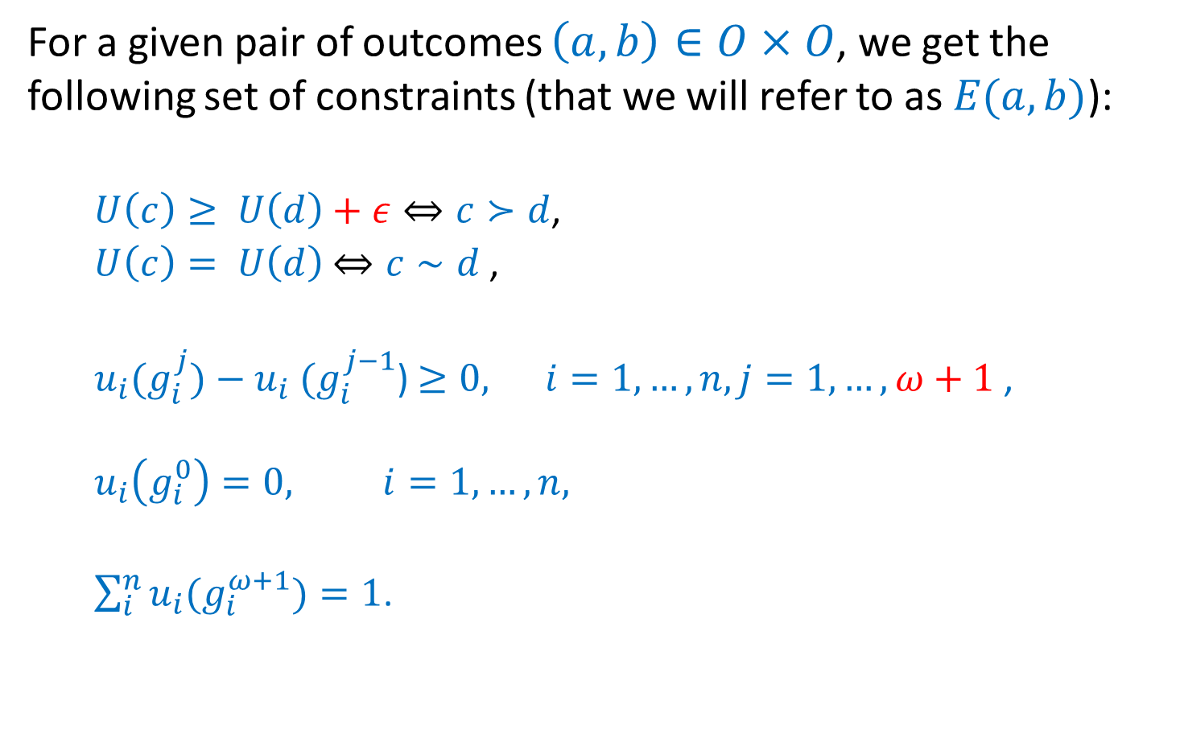

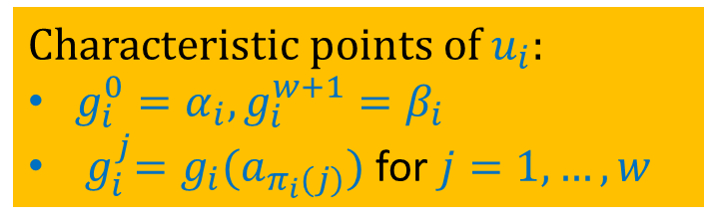

Ordinal Regression Constraints E(a,b)
For a given pair of outcomes $\left(a,b\right)∈O×O$, we get the following set of constraints (that we will refer to as $E(a,b)$):
$U\left(c\right)≥ U\left(d\right)+ε⇔c≻d$,
$U\left(c\right)= U\left(d\right)$ $⇔c∼d$ ,
$u_{i}(g_{i}^{j}){− u}_{i}(g_{i}^{j−1}$) $≥0, i=1,…,n, j=1,…,ω+1$,
$$u_{i}\left(g_{i}^{0}\right)=0, i=1,…,n,$$
$\sum_{i}^{n}{u_{i}(g_{i}^{ω+1})=1}$.
$$∀c,d∈O^{R}$$
Characteristic points of $u_{i}$:
$g_{i}^{0}=α_{i},g_{i}^{w+1}=β_{i}$
${ g}_{i}^{j}=g_{i}(a_{π_{i}(j)})$ for $j=1,…,w$
Note that $E(a,b) = E(b,a).$

Slide 54



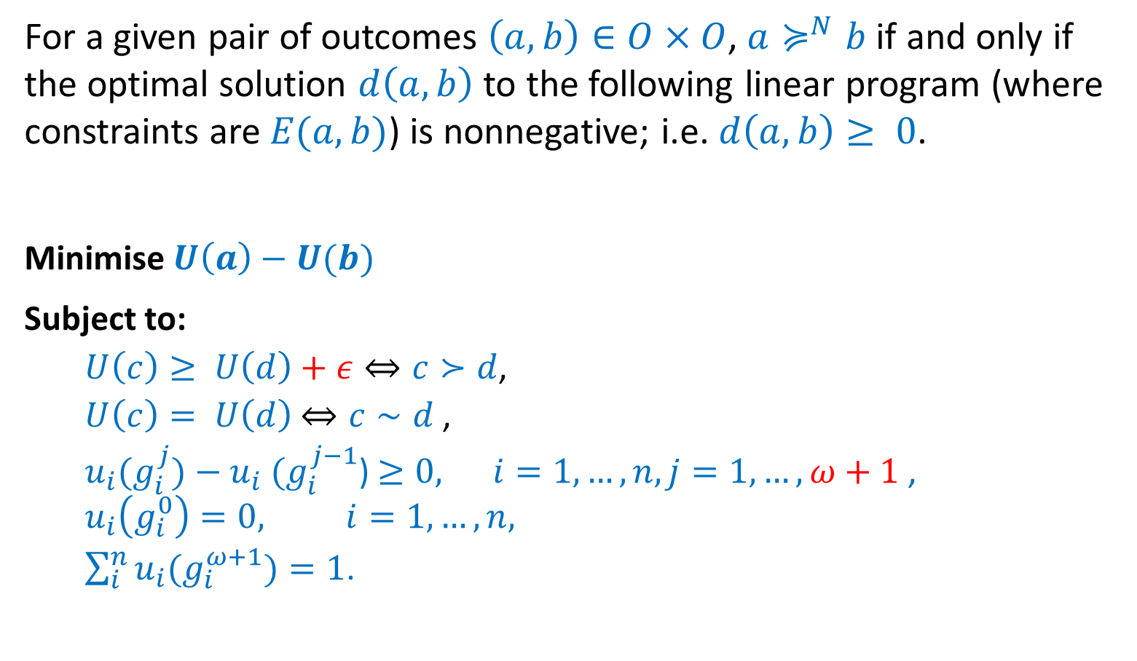
Linear Programs to compute $≽^{N}$
For a given pair of outcomes $\left(a,b\right)∈O×O$, $a≽^{N}b$ if and only if the optimal solution $d\left(a,b\right)$ to the following linear program (where constraints are $E(a,b)$) is nonnegative; i.e. $d\left(a,b\right)≥ 0$.
Minimise $U\left(a\right)−U(b)$
Subject to:
$U\left(c\right)≥ U\left(d\right)+ε⇔c≻d$,
$U\left(c\right)= U\left(d\right)$ $⇔c∼d$ ,
$u_{i}(g_{i}^{j}){− u}_{i}(g_{i}^{j−1}$) $≥0, i=1,…,n, j=1,…,ω+1$,
$$u_{i}\left(g_{i}^{0}\right)=0, i=1,…,n,$$
$\sum_{i}^{n}{u_{i}(g_{i}^{ω+1})=1}$.
$$∀c,d∈O^{R}$$
Characteristic points of $u_{i}$
$g_{i}^{0}=α_{i},g_{i}^{w+1}=β_{i}$
${ g}_{i}^{j}=g_{i}(a_{π_{i}(j)})$ for $j=1,…,w$

Slide 55

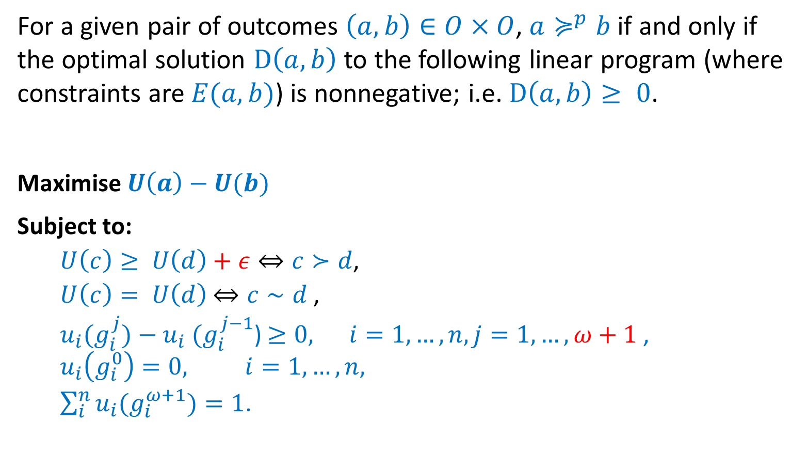
Linear Programs to compute $≽^{P}$
For a given pair of outcomes $\left(a,b\right)∈O×O$, $a≽^{p}b$ if and only if the optimal solution $D\left(a,b\right)$ to the following linear program (where constraints are $E(a,b)$) is nonnegative; i.e. $D\left(a,b\right)≥ 0$.
Maximise $U\left(a\right)−U(b)$
Subject to:
$U\left(c\right)≥ U\left(d\right)+ε⇔c≻d$,
$U\left(c\right)= U\left(d\right)$ $⇔c∼d$ ,
$u_{i}(g_{i}^{j}){− u}_{i}(g_{i}^{j−1}$) $≥0, i=1,…,n, j=1,…,ω+1$,
$$u_{i}\left(g_{i}^{0}\right)=0, i=1,…,n,$$
$\sum_{i}^{n}{u_{i}(g_{i}^{ω+1})=1}$.
$$∀c,d∈O^{R}$$
Characteristic points of $u_{i}$
$g_{i}^{0}=α_{i},g_{i}^{w+1}=β_{i}$
${ g}_{i}^{j}=g_{i}(a_{π_{i}(j)})$ for $j=1,…,w$

Slide 56
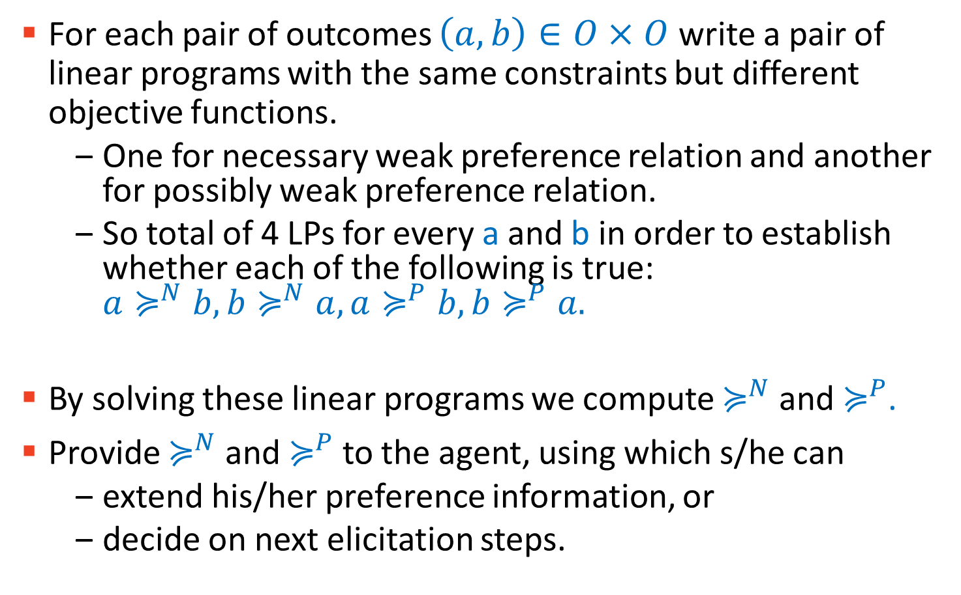
Summary of UTA^{GMS}
For each pair of outcomes $\left(a,b\right)∈O×O$write a pair of linear programs with the same constraints but different objective functions.
One for necessary weak preference relation and another for possibly weak preference relation.
So total of 4 LPs for every a and b in order to establish whether each of the following is true: ${a≽}^{N}b,{b≽}^{N}a,{a≽}^{P}b,{b≽}^{P}a.$
By solving these linear programs we compute $≽^{N}$ and $≽^{P}$.
Provide $≽^{N}$ and $≽^{P}$ to the agent, using which s/he can
extend his/her preference information, or
decide on next elicitation steps.

Slide 57
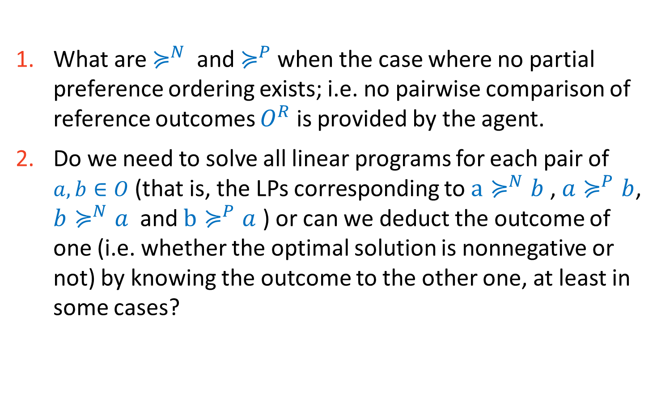
Assignment for you
What are $≽^{N}$ and $≽^{P}$ when the case where no partial preference ordering exists; i.e. no pairwise comparison of reference outcomes $O^{R}$ is provided by the agent.
Do we need to solve all linear programs for each pair of $a, b∈O$ (that is, the LPs corresponding to $a≽^{N}b$ , ${a≽}^{P}b$, ${b≽}^{N}a$ and $b≽^{P}a$ ) or can we deduct the outcome of one (i.e. whether the optimal solution is nonnegative or not) by knowing the outcome to the other one, at least in some cases?

Slide 58
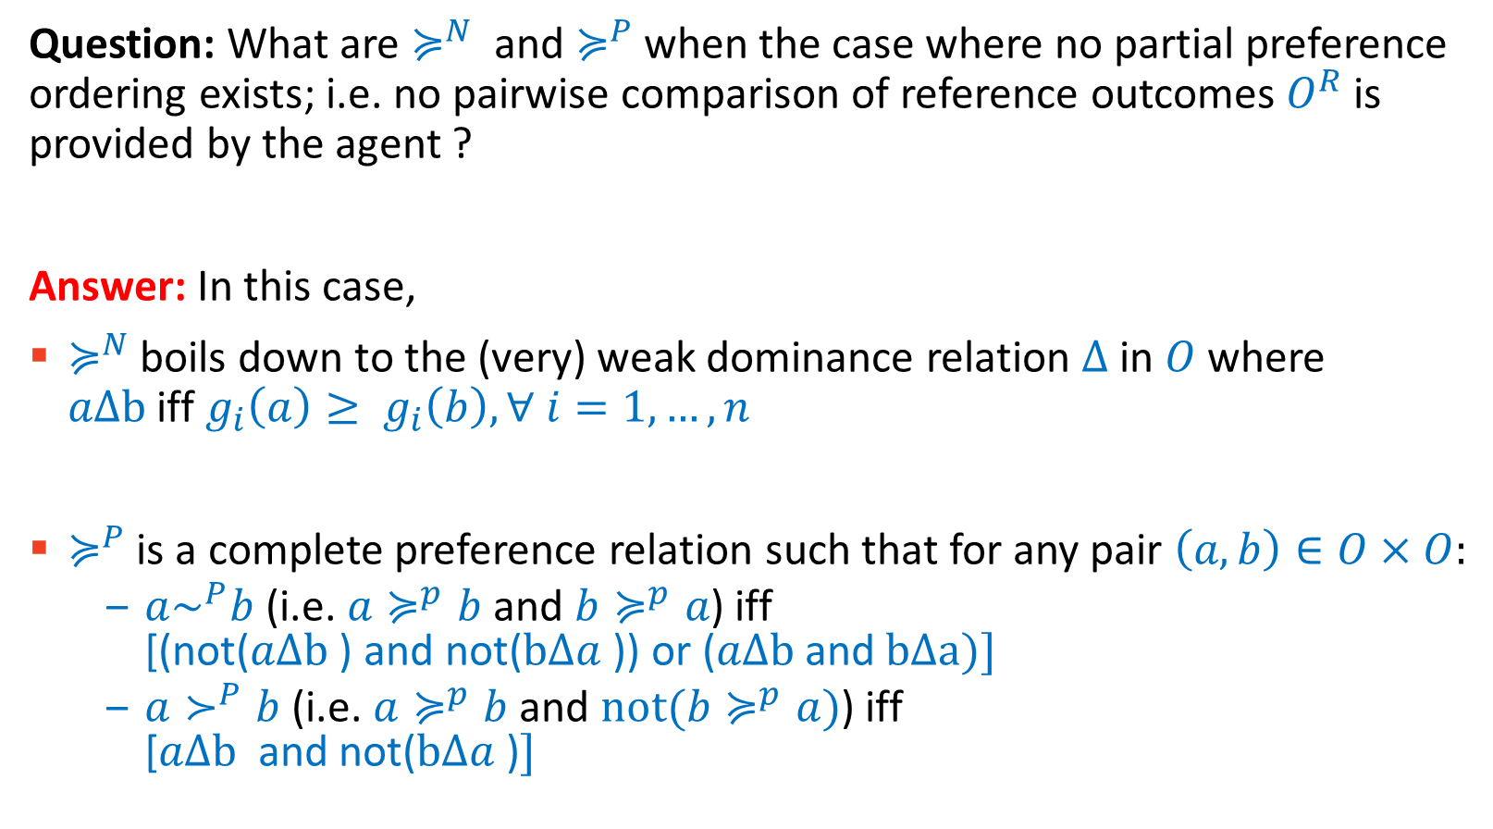
Assignment for you: 1 of 2
Question: What are $≽^{N}$ and $≽^{P}$ when the case where no partial preference ordering exists; i.e. no pairwise comparison of reference outcomes $O^{R}$ is provided by the agent ?
Answer: In this case,
$≽^{N}$ boils down to the (very) weak dominance relation $Δ$in $O$ where $aΔb$iff $g_{i}\left(a\right)≥ g_{i}\left(b\right), ∀ i=1,…,n$
$≽^{P}$ is a complete preference relation such that for any pair $\left(a,b\right)∈O×O:$
$a\sim ^{P}b$ (i.e. $a≽^{p}b$and $b≽^{p}a$) iff [(not($aΔb$) and not($bΔa$)) or ($aΔb$and $bΔa)]$
$a≻^{P}b$ (i.e. $a≽^{p}b$and $not(b≽^{p}a)$) iff [$aΔb$ and not($bΔa$)$]$
Notes:
\equil^p holds when either (second case) g_i(a)=g_i(b) for all i (so the evaluation of both on each issue is the same) or (first case) neither is weakly dominating the other one (so at least there is one issue i where g_i(a) > g_i(b) and at least one issue j where g_j(b)> g_j(a)).
\succ^p holds when a is weakly dominating b but not the other way around. So when g_i(a)>=g_i(b) on all issues and g_i(a) > g_i(b) for at least one issue i. (Note that \delta is not weak dominance as defined in Enrico M’s lecture. This one is what Enrico would call very weak dominance.]

Slide 59
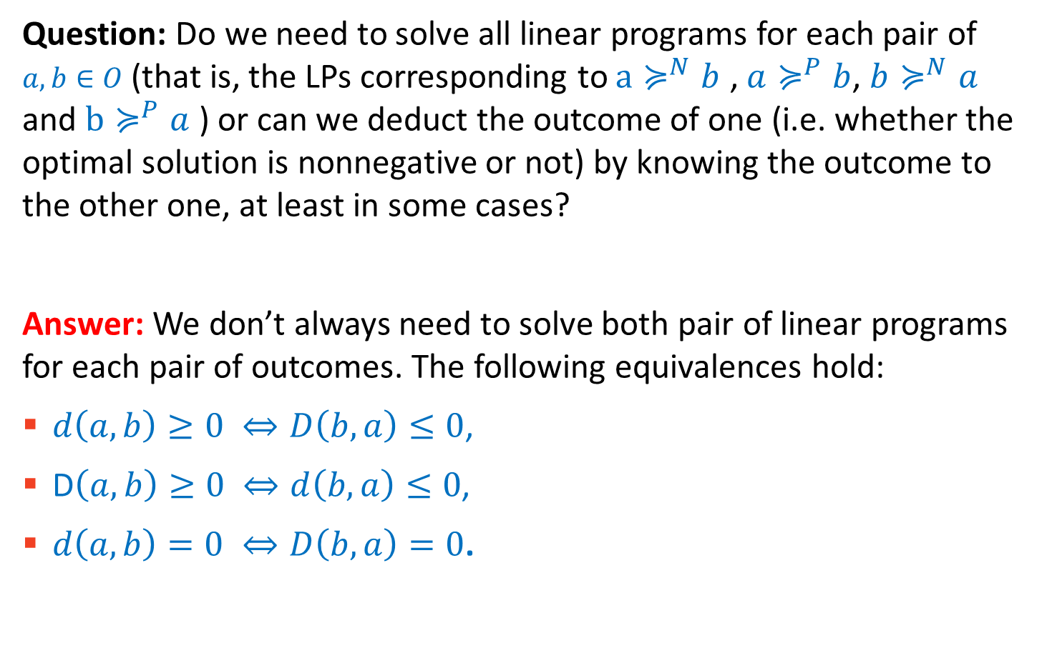
Assignment for you: 2 of 2
Question: Do we need to solve all linear programs for each pair of $a, b∈O$ (that is, the LPs corresponding to $a≽^{N}b$ , ${a≽}^{P}b$, ${b≽}^{N}a$ and $b≽^{P}a$ ) or can we deduct the outcome of one (i.e. whether the optimal solution is nonnegative or not) by knowing the outcome to the other one, at least in some cases?
Answer: We don’t always need to solve both pair of linear programs for each pair of outcomes. The following equivalences hold:
$d\left(a,b\right)≥0 ⇔D\left(b,a\right)≤0$,
D$\left(a,b\right)≥0 ⇔d\left(b,a\right)≤0$,
$d\left(a,b\right)=0 ⇔D\left(b,a\right)=0$.
Notes:
d(a,b) = minimize U(a)-U(b).
D(a,b) = maximise U(a) – U(b).
d(a,b)>=0 implies that U(a)>=U(b) for all compatible … hence U(b)<=U(a) for all compatible and hence D(b,a) <=0.

Slide 60
Further Reading:
Robust Ordinal Regression, by S. Greco, R. Słowinski, J. R. Figueira, and V. Mousseau. In ``Trends in Multiple Criteria Decision Analysis’’, Chapter 9, 2010. [a summary of related work until 2010] https://https://link.springer.com/chapter/10.1007/978-1-4419-5904-1_9
UTA Method, by Y. Siskos, E. Grigoroudis, and N. F. Matsatsinis. In ``Multiple Criteria Decision Analysis: State of the Art Surveys’’, Chapter 7, 2005. [on variants of UTA methods] https://link.springer.com/chapter/10.1007/0-387-23081-5_8
Ordinal Regression Revisited: Multiple Criteria Ranking Using a Set of Additive Value Functions, S. Greco, V. Mousseau, and R. Słowinski. European Journal of Operation Research, 2008 [UTA^{GMS} paper] https://www.sciencedirect.com/science/article/pii/S0377221707008752

Slide 61
And even further reading:
Preference Disaggregation in Multiple Criteria Decision Analysis, Essays in Honor of Yannis Siskos, Editors: N. F. Matsatsinis and E. Grigoroudis, 2018 https://www.springer.com/gp/book/9783319905983
Automated Negotiations Under User Preference Uncertainty: A Linear Programming Approach, by D. Tsimpoukis, T. Baarslag, M. Kaisers, and N. G. Paterakis. In ``Agreement Technologies’’, 2018. [extension to categorical data] https://link.springer.com/chapter/10.1007/978-3-030-17294-7_9

Slide 62
And more further reading (on elicitation in other settings):
Learning to Rank Using Gradient Descent, by C. Burges and A. Lazier, In the proceedings of the 22nd international conference on Machine Learning (ICML), 2005. [on presenting ranked order of results, such as news feed, ads, … to users] https://icml.cc/2015/wp-content/uploads/2015/06/icml_ranking.pdf

